Slide 2



Who we are
What we do
EuroDev is a company of dedicated, experienced, multilingual business developers who assist internationally oriented North American medium-sized organizations with a strategic focus to develop the European market.
For the past 26 years, EuroDev has partnered up with over 500 US and Canadian companies to help them expand to the European market.
​
We are all about international business and personal development!
SALES OUTSOURCING​​
Market research, entry strategy, lead generation and sales
HR OUTSOURCING​​
European region recruitment, employment and HR outsourcing services
DIGITAL MARKETING​​
Online strategy development to drive engagement with B2B buyers

Slide 3
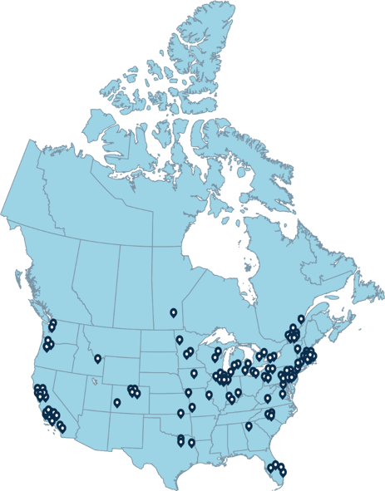
OUR CLIENTS​

Slide 4
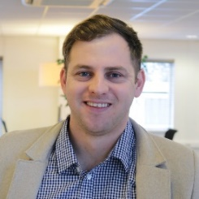
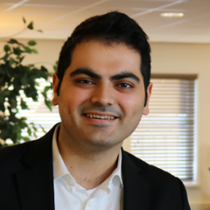
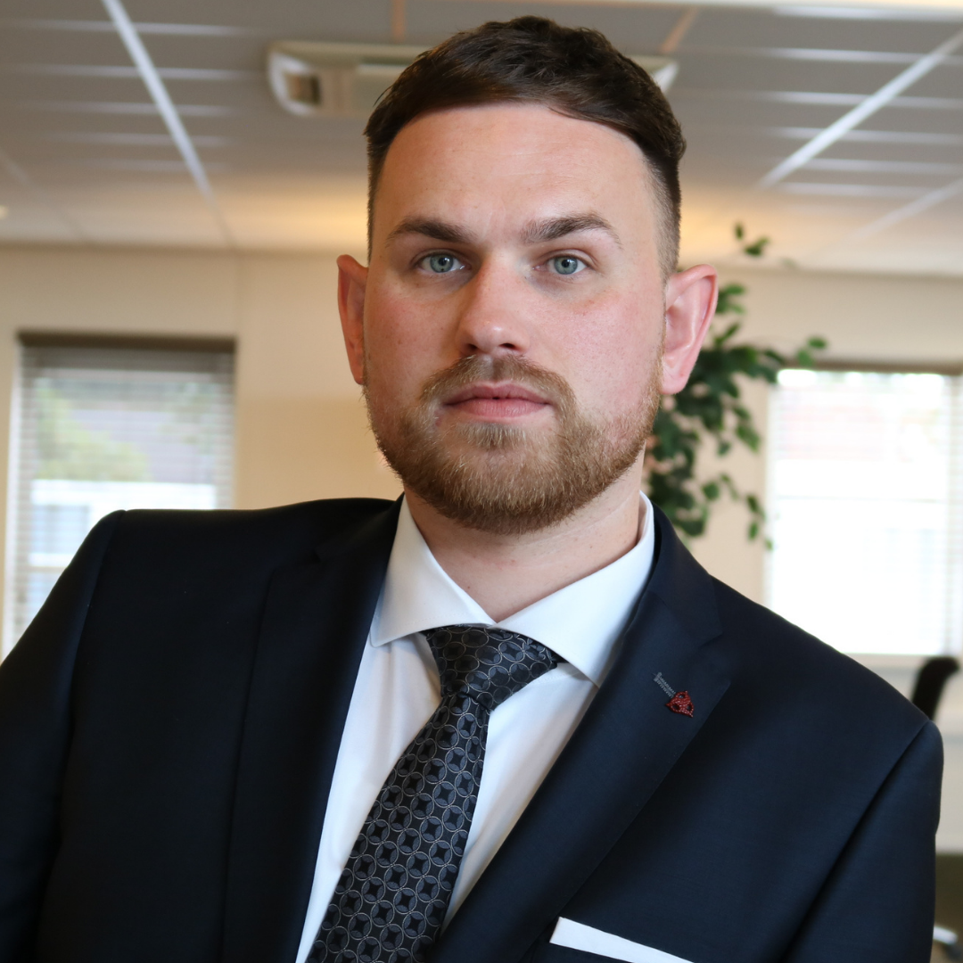
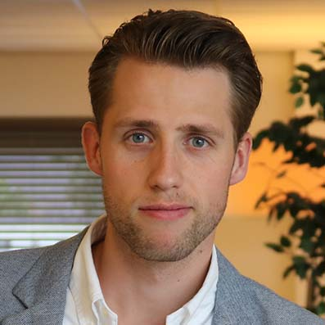
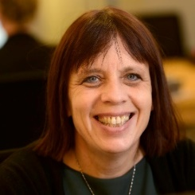
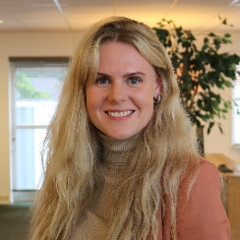
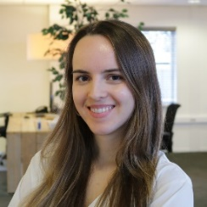
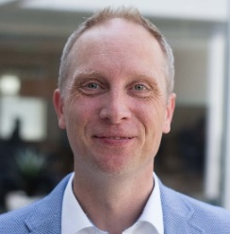
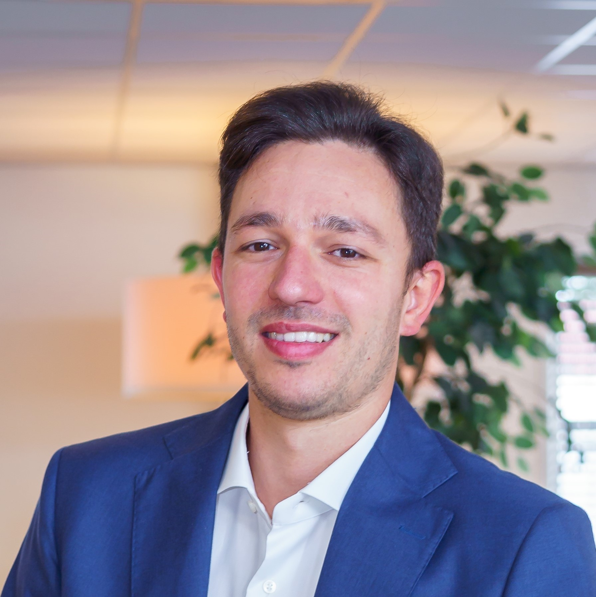
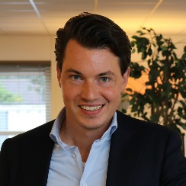
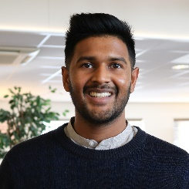
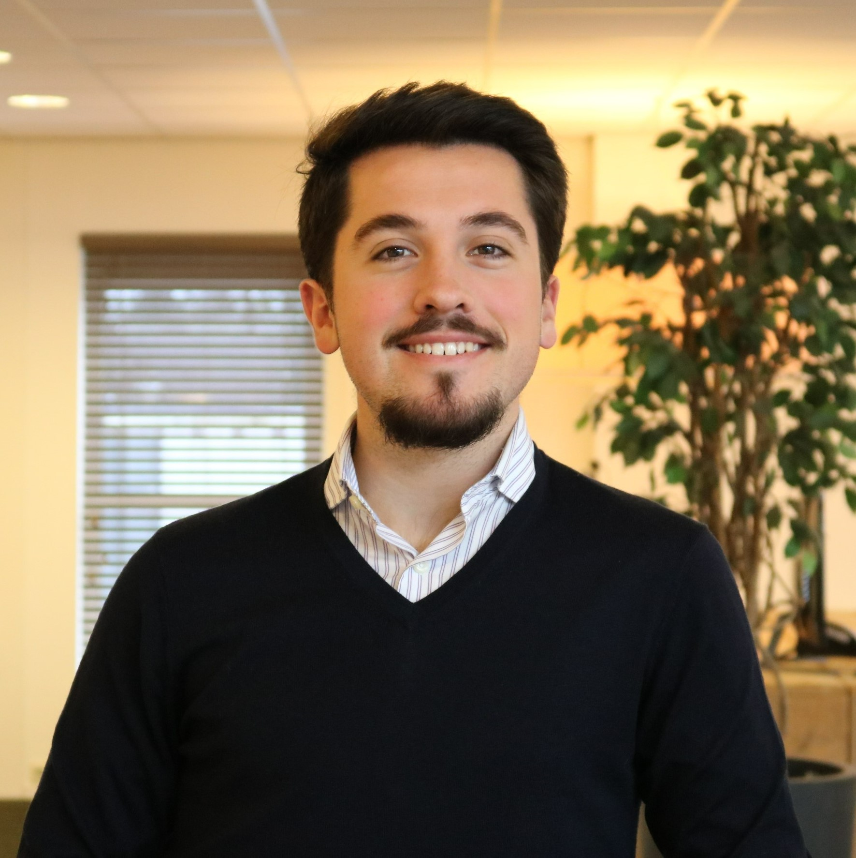
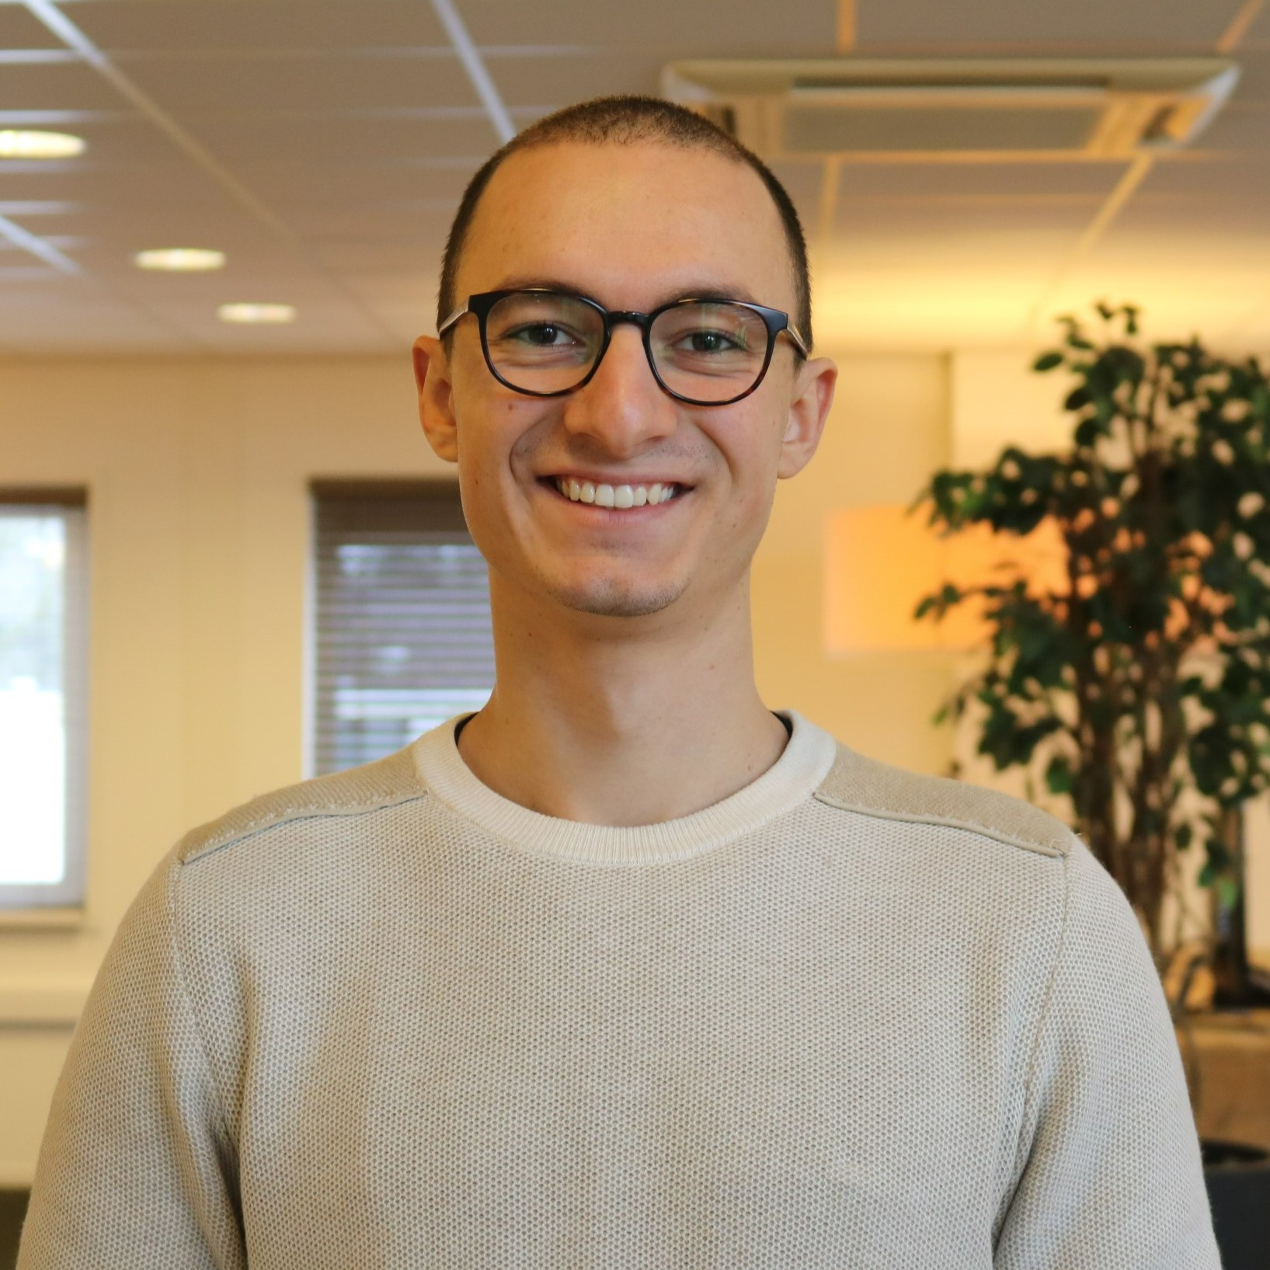
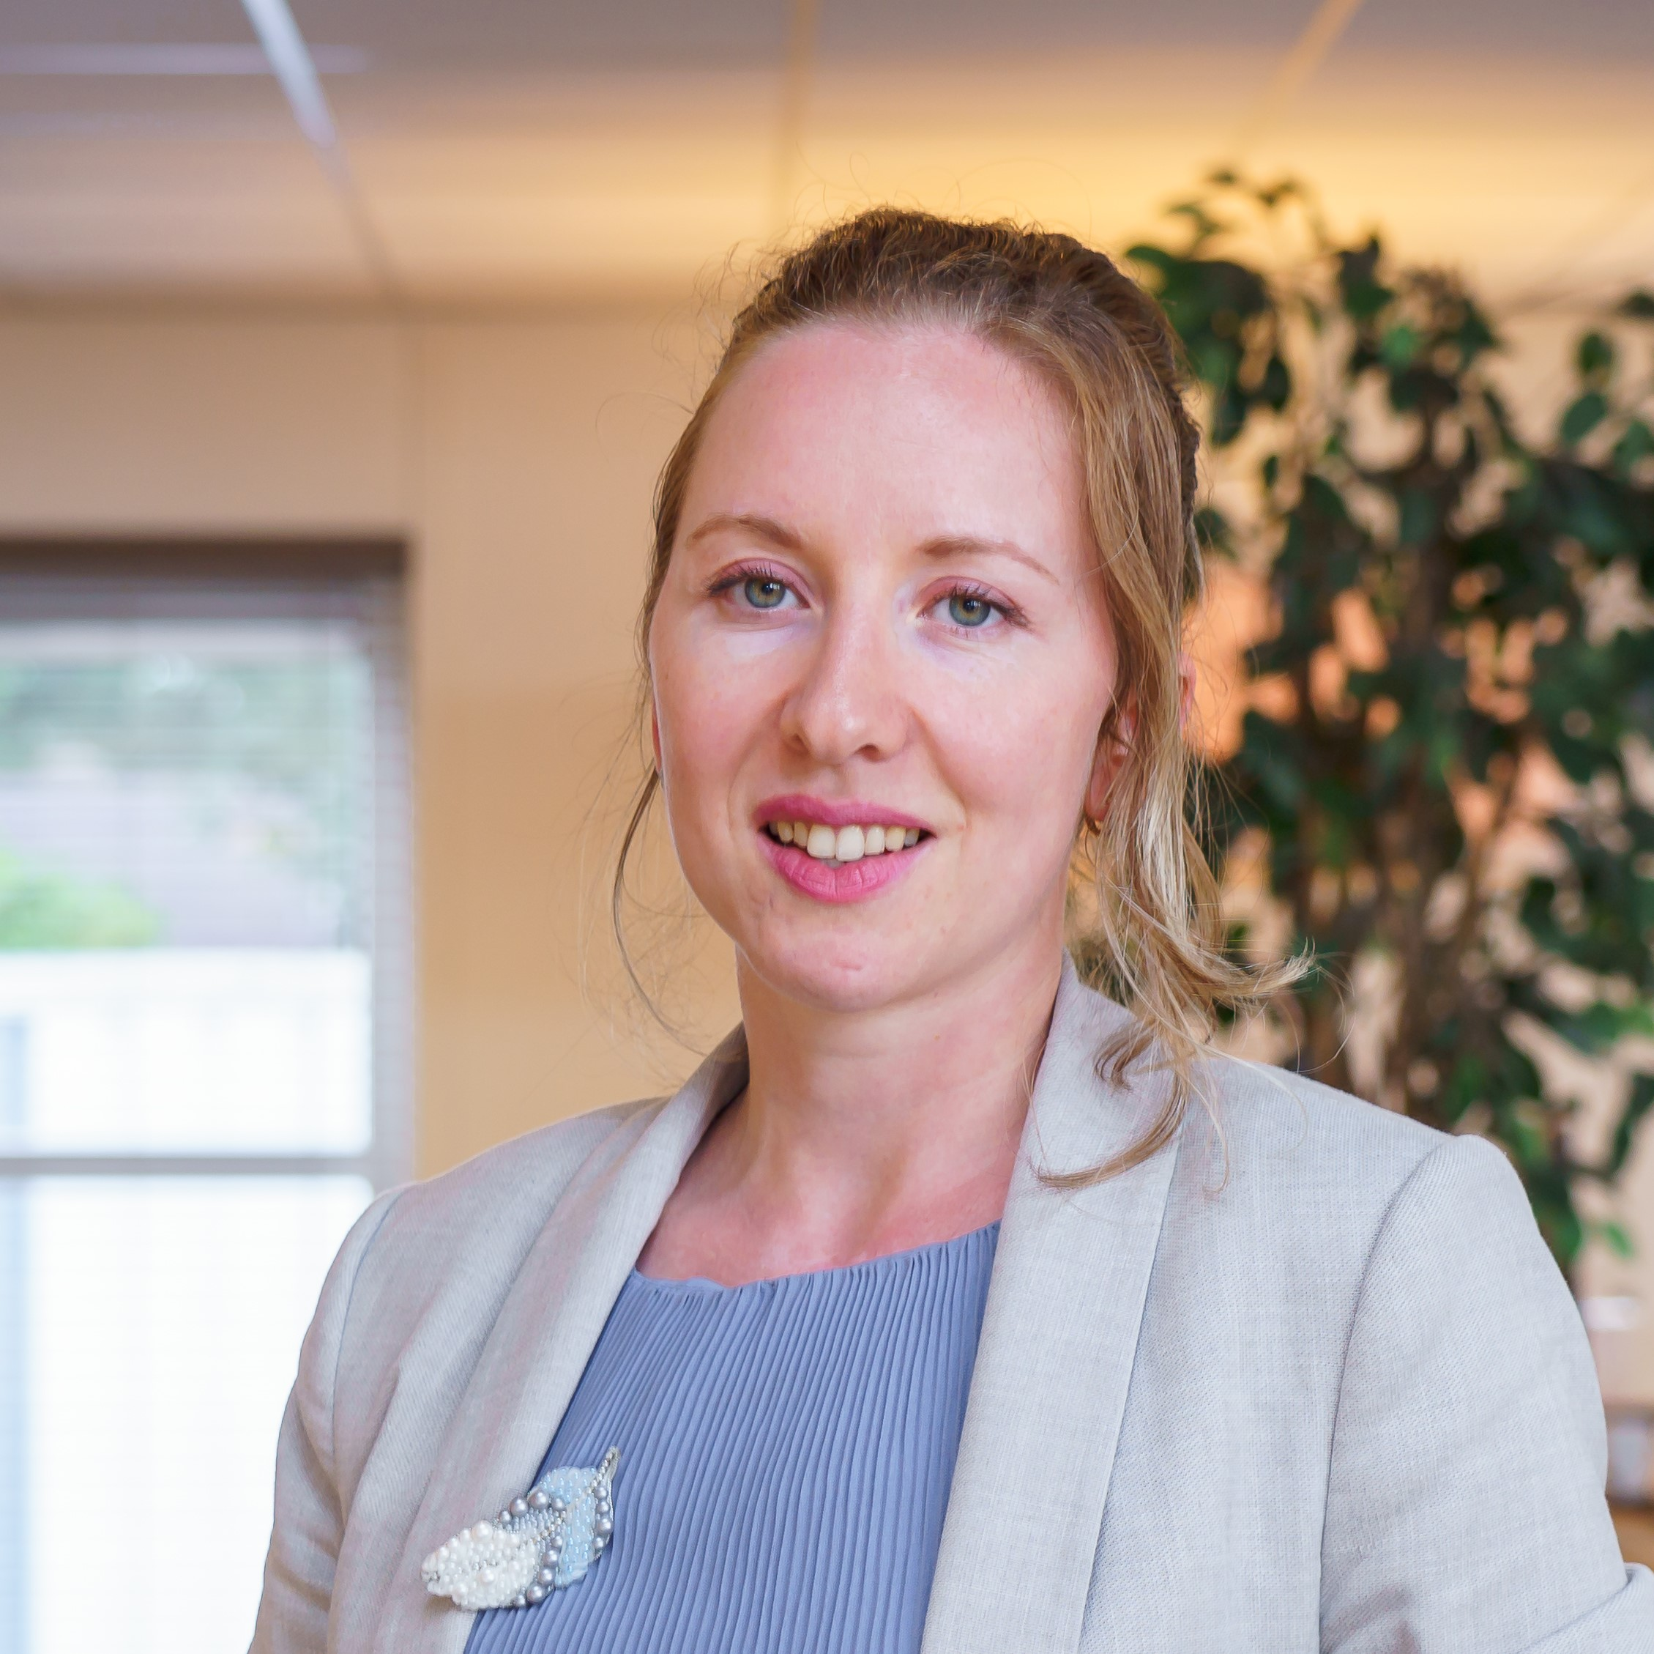
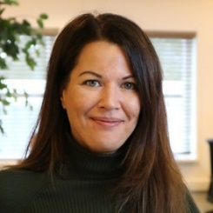
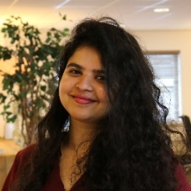
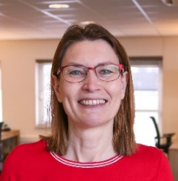
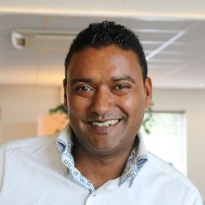
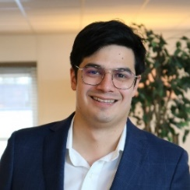
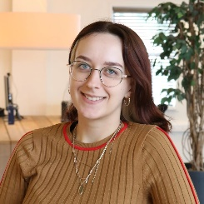
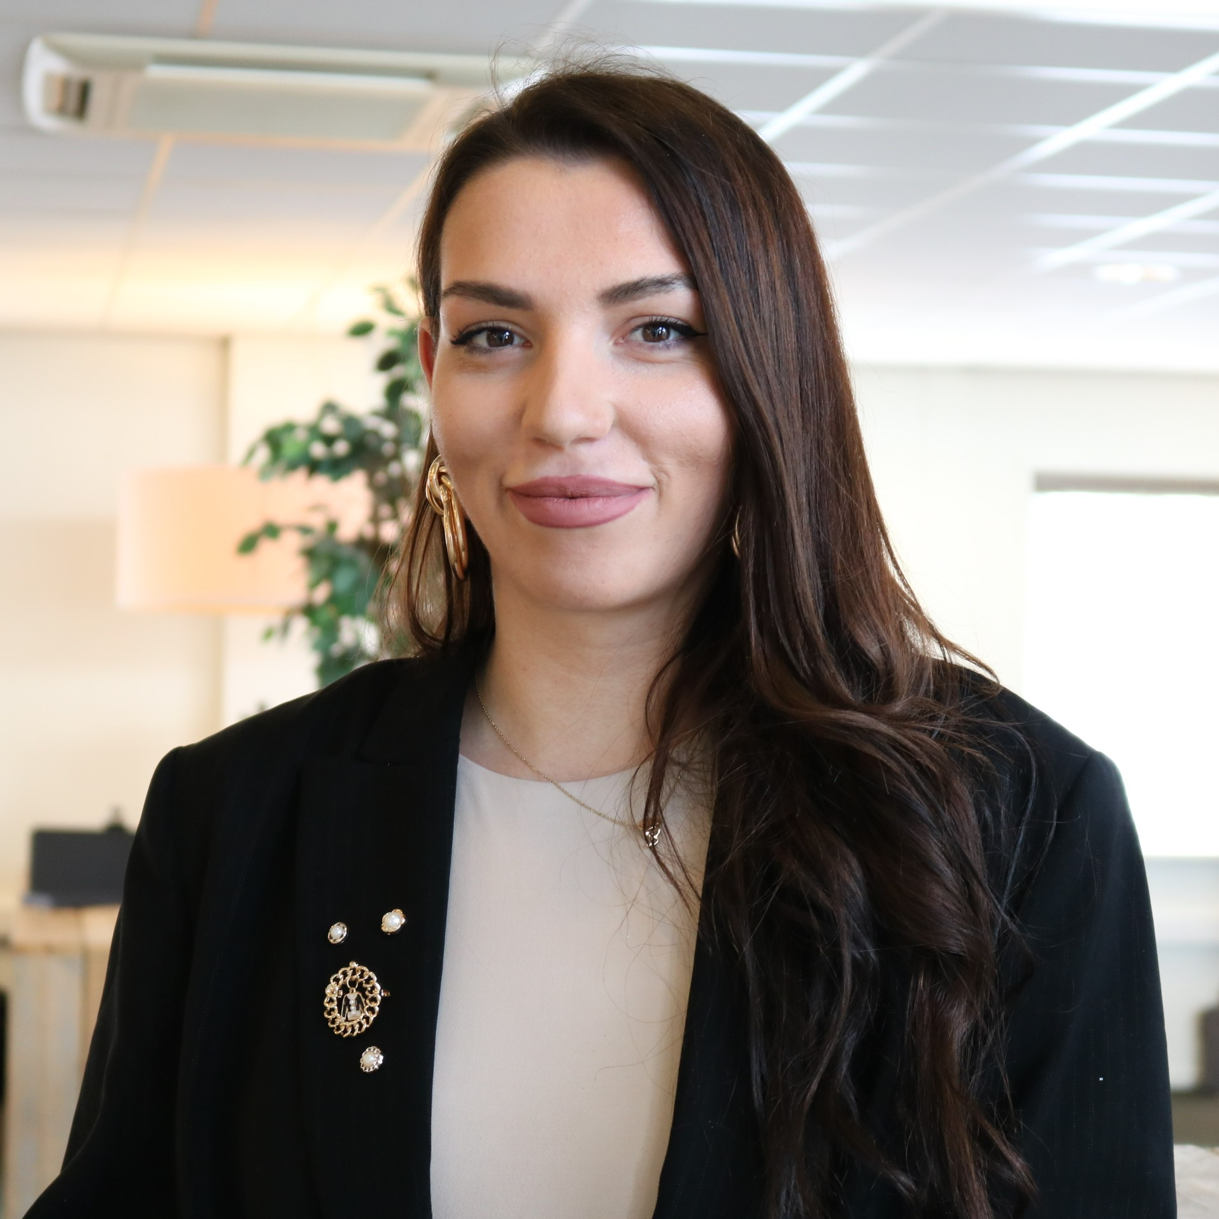
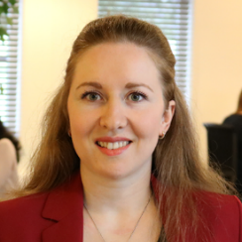
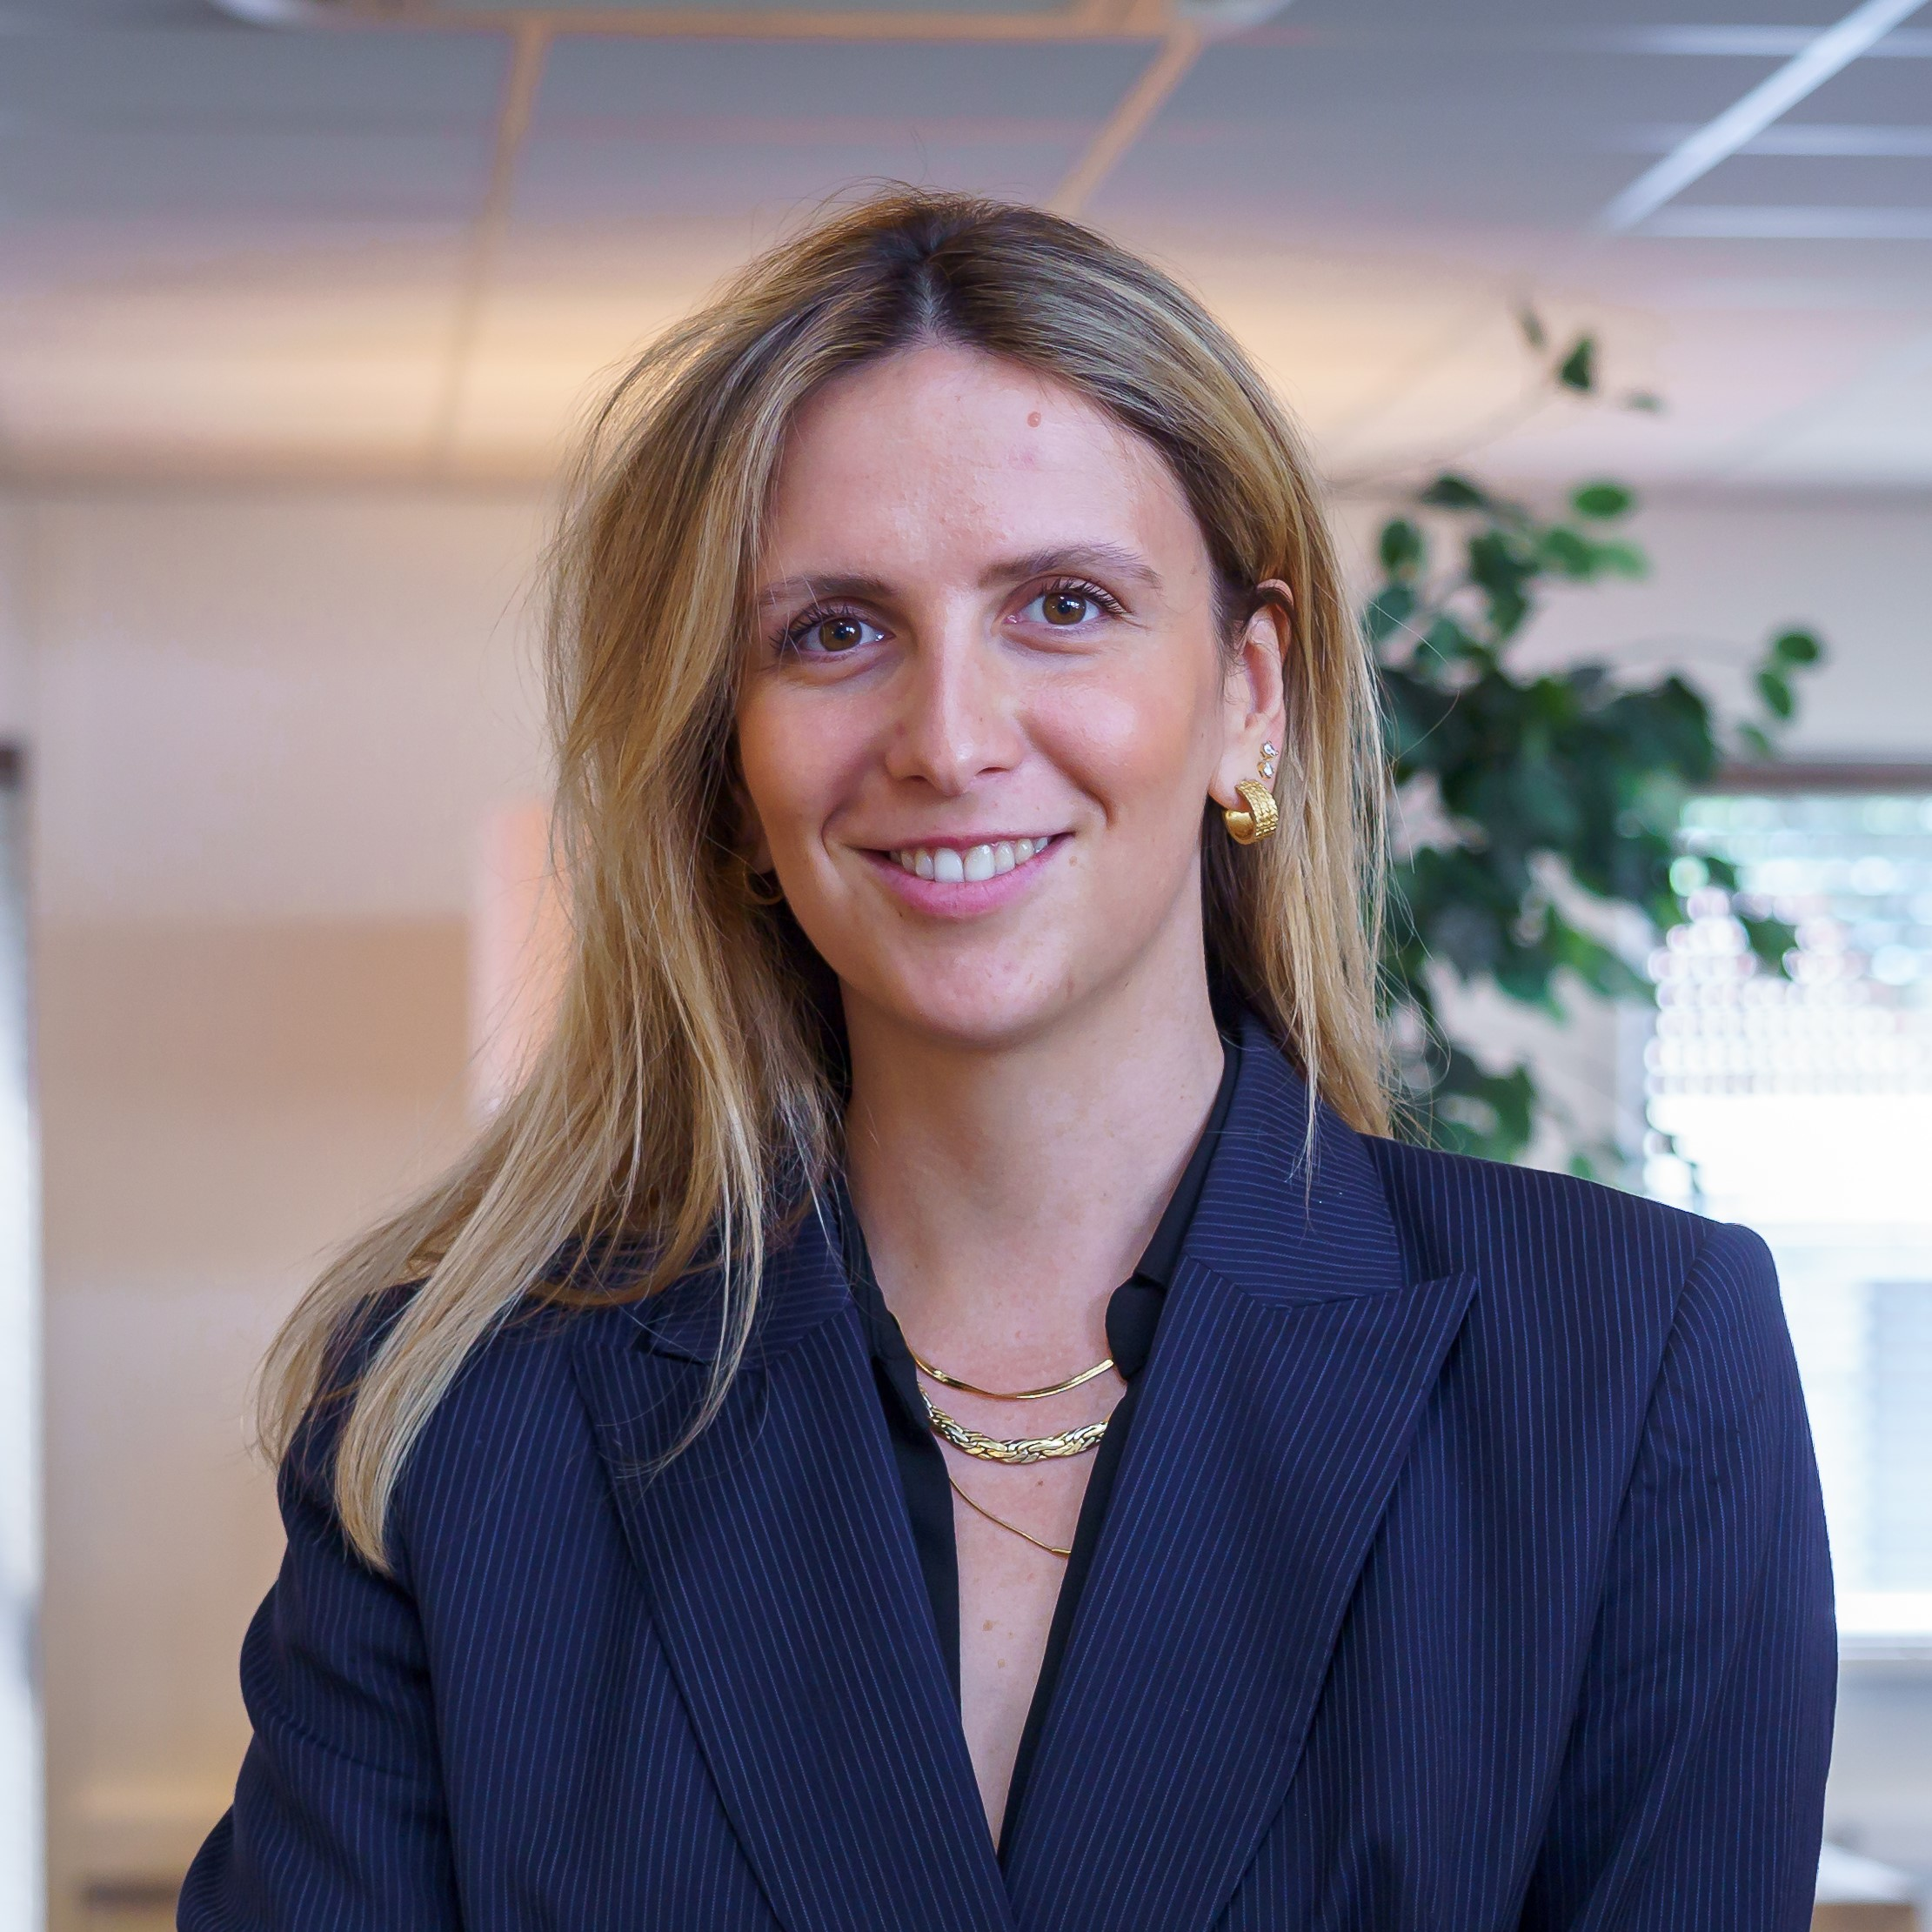
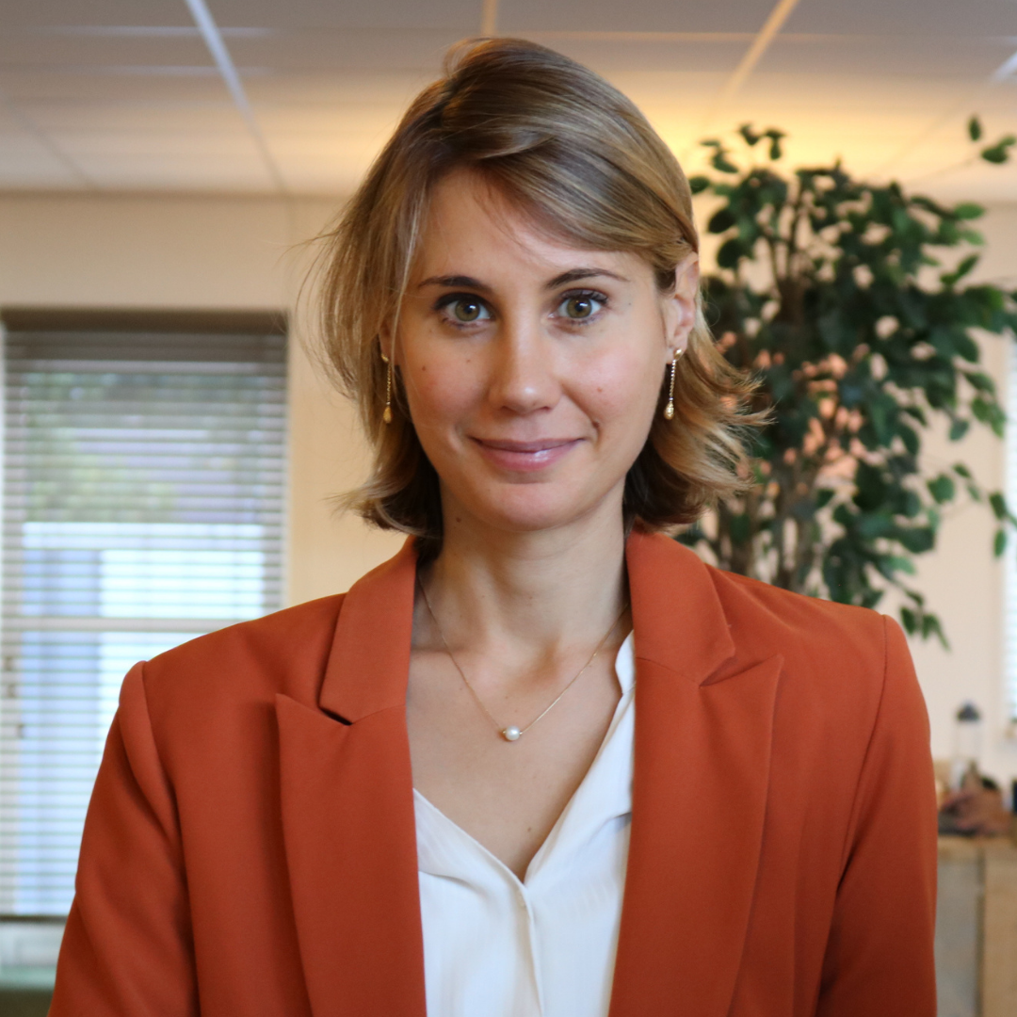
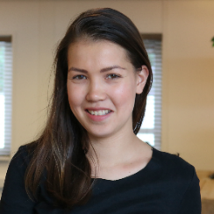
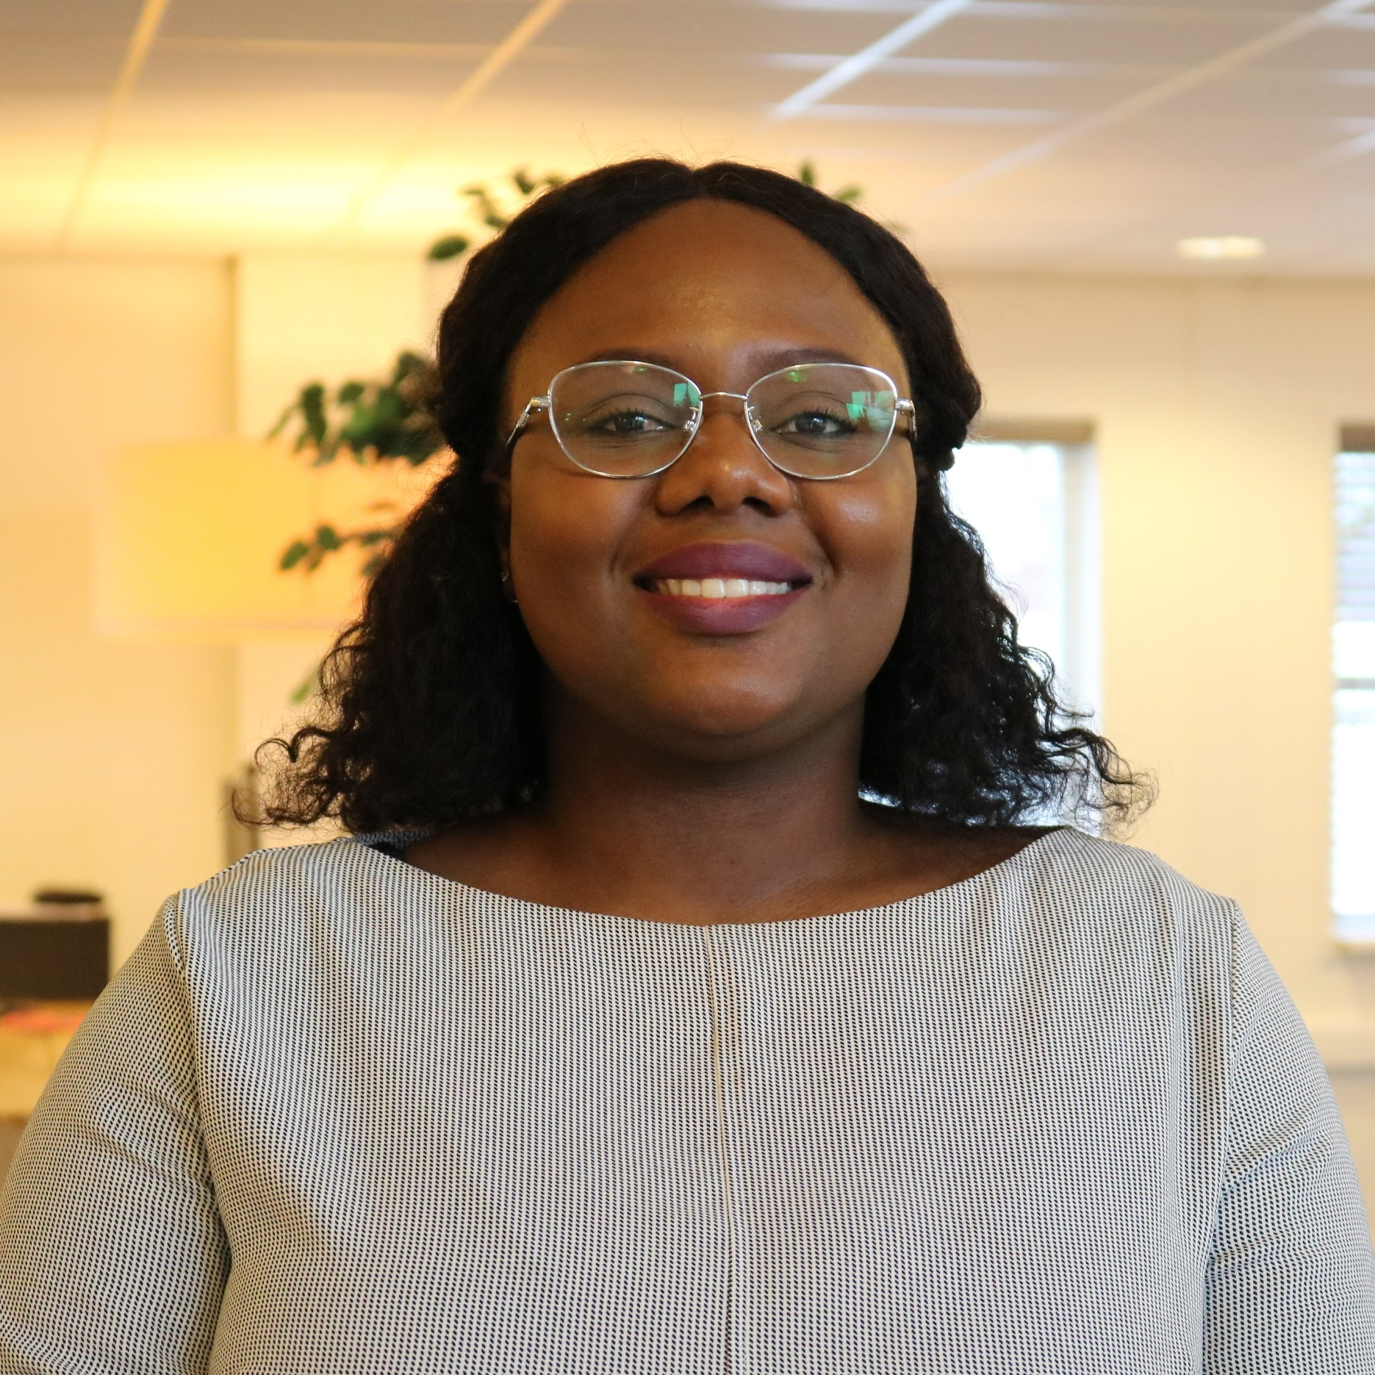
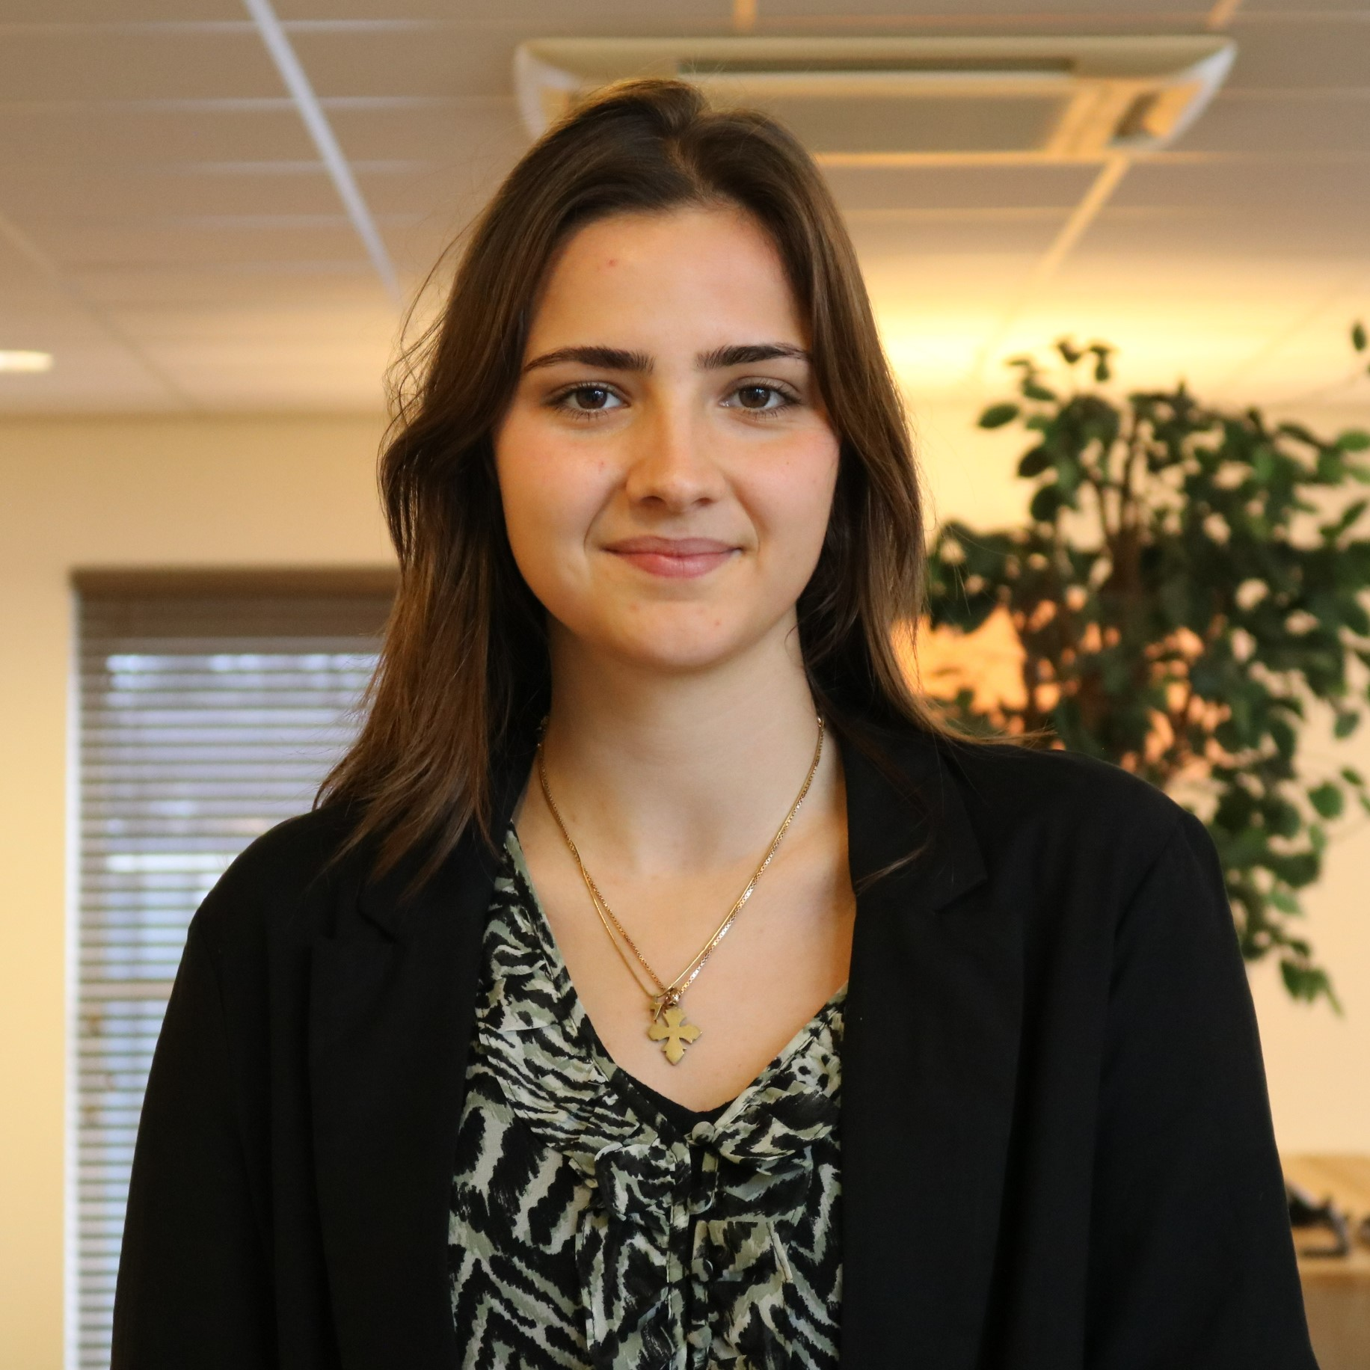
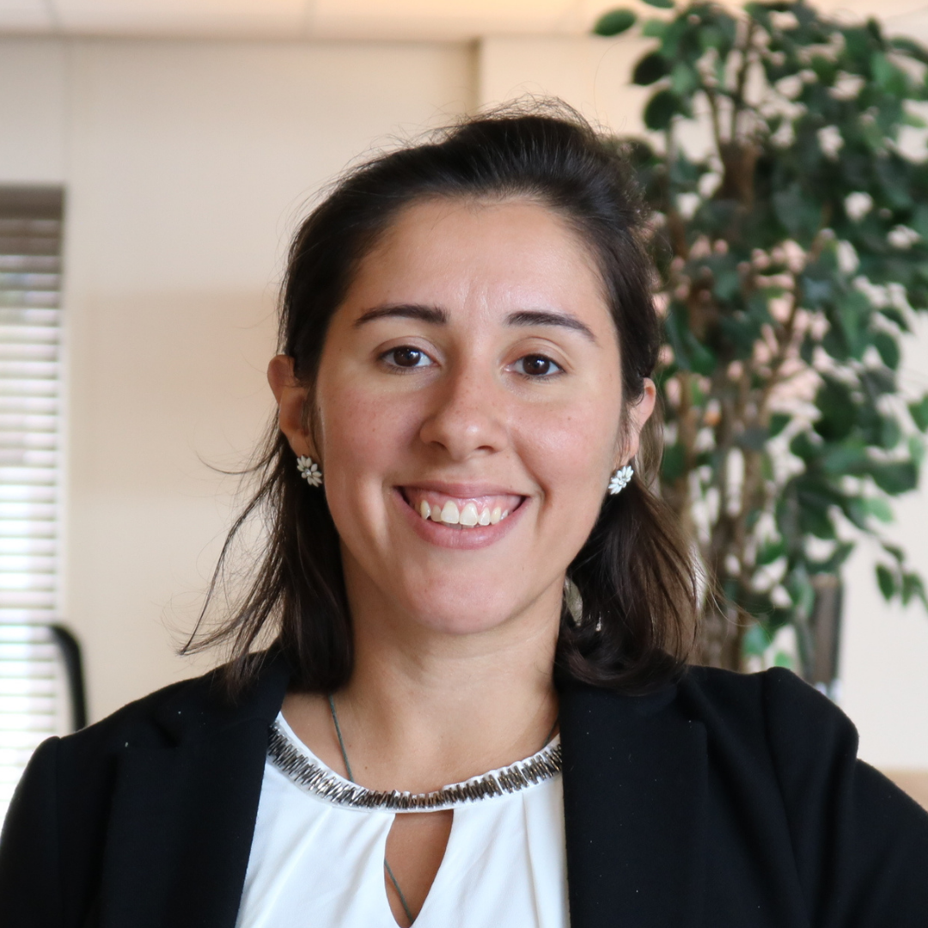
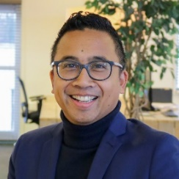
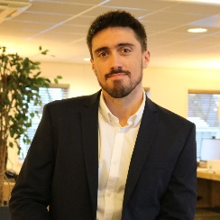
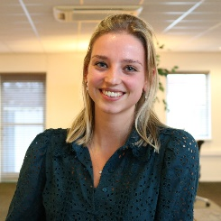
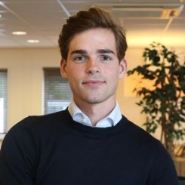
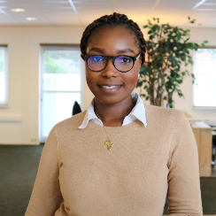
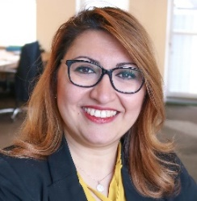
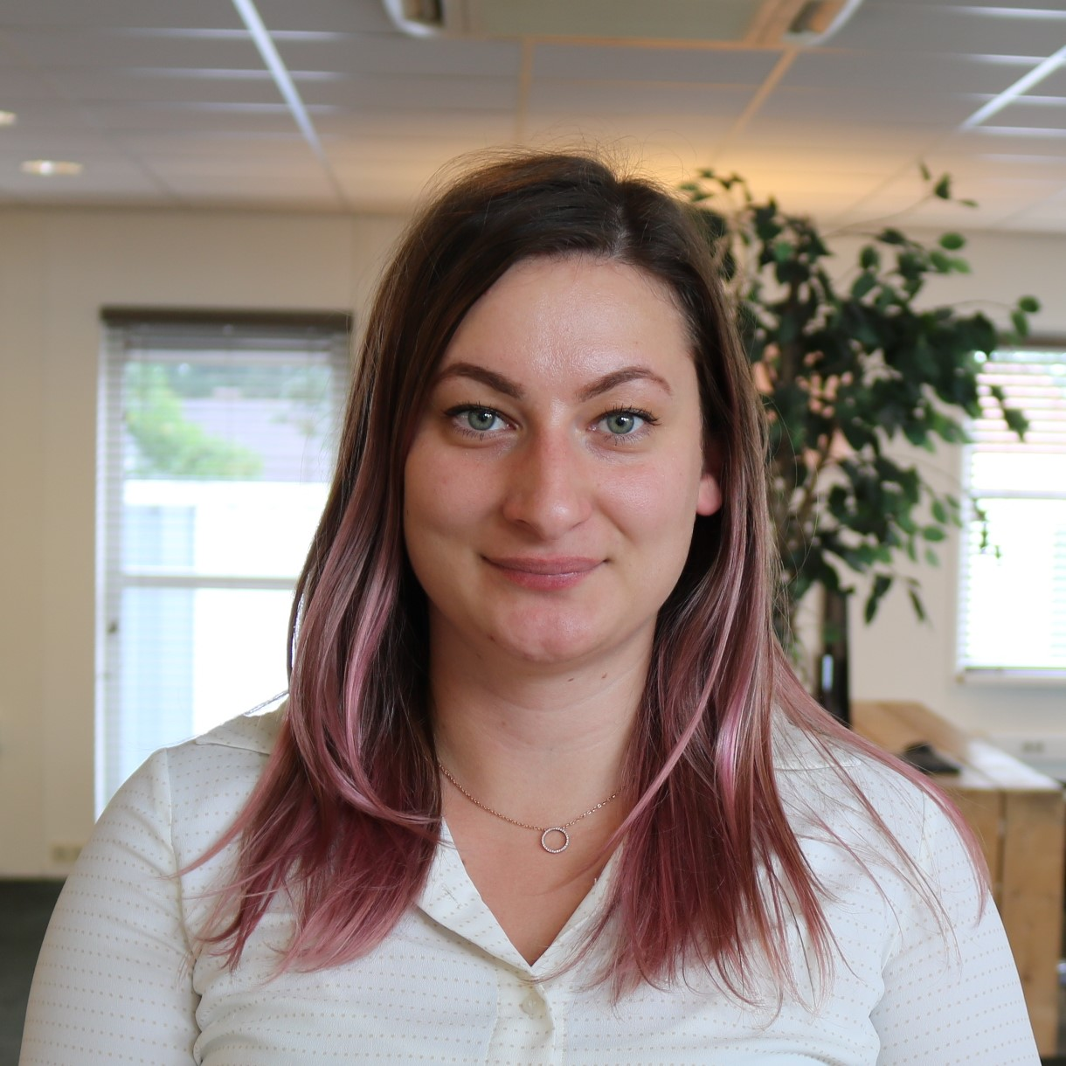
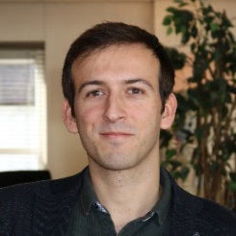
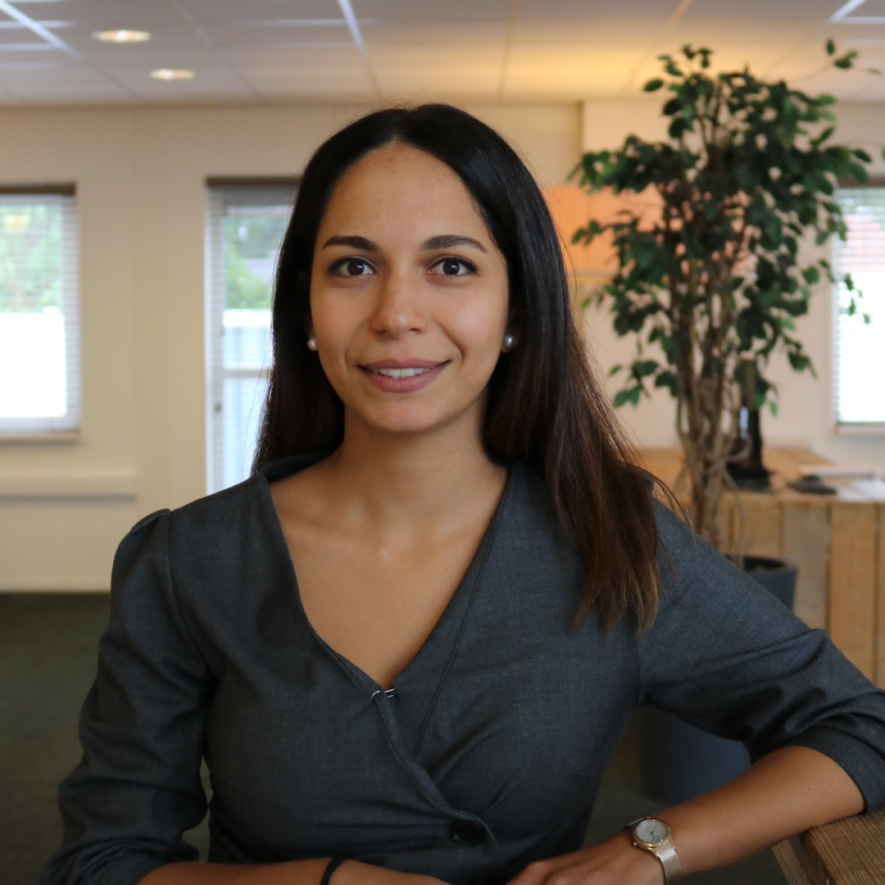
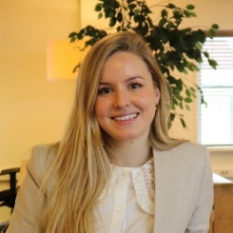
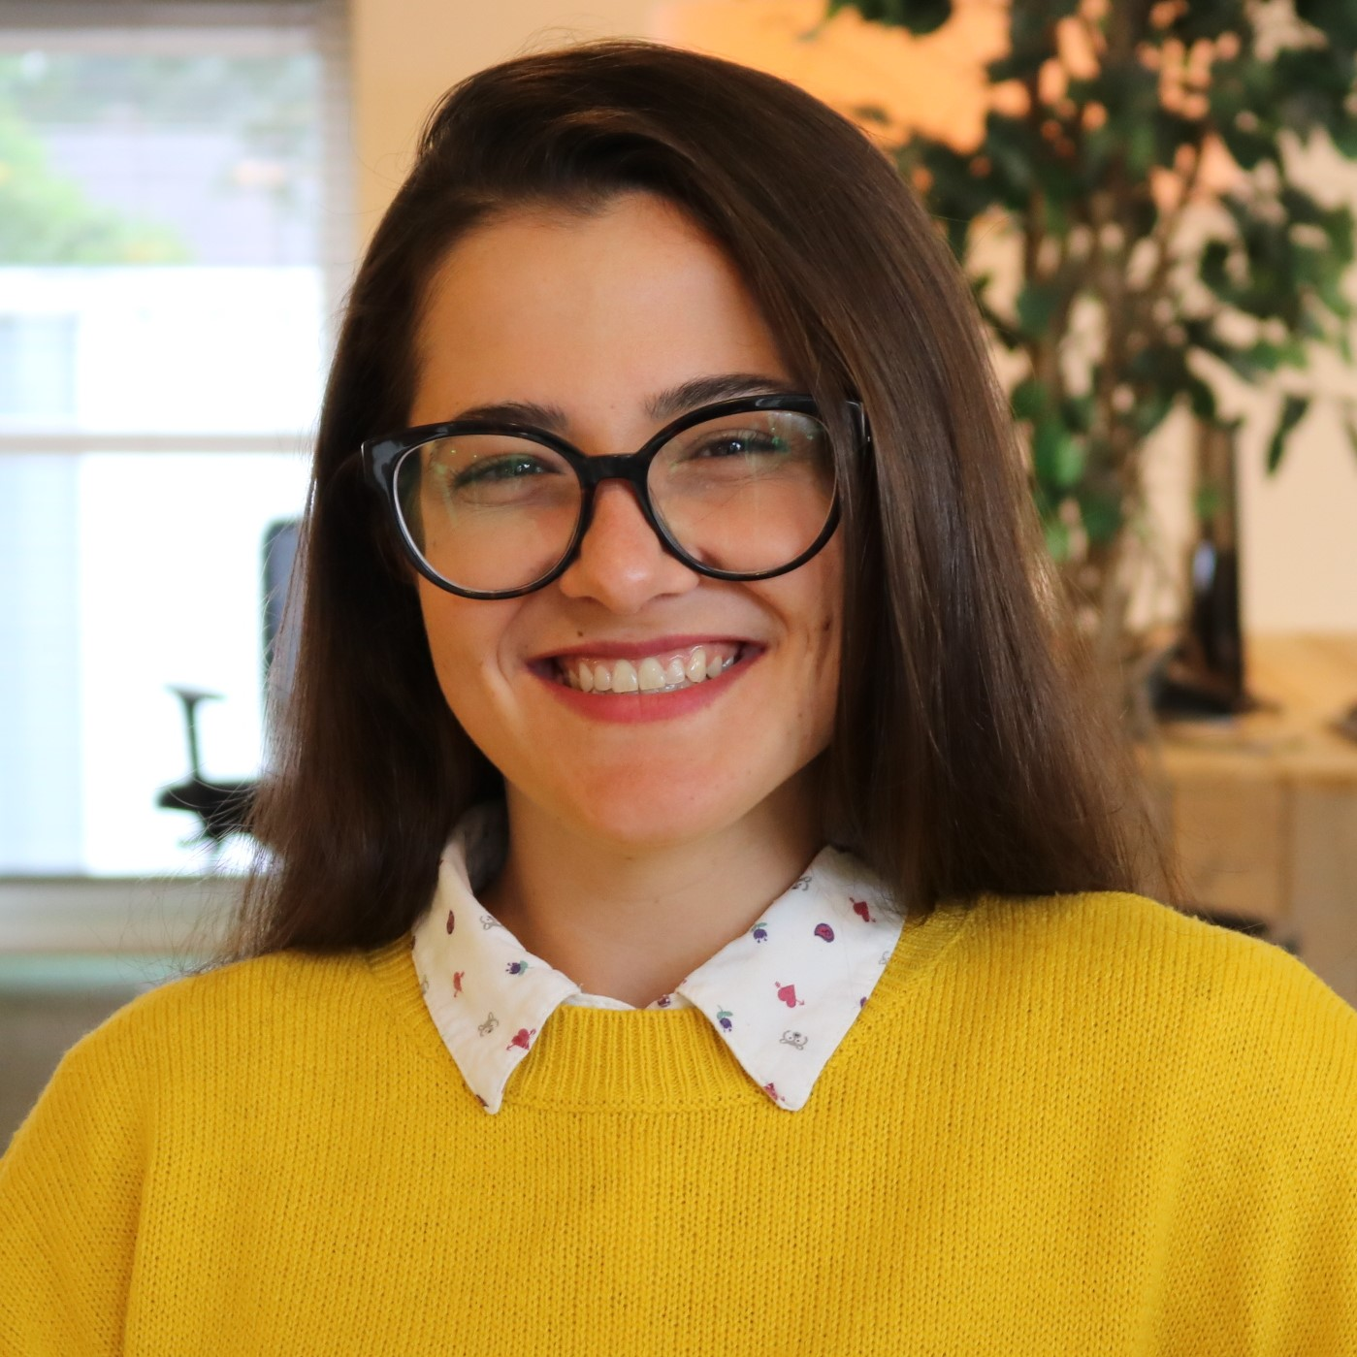
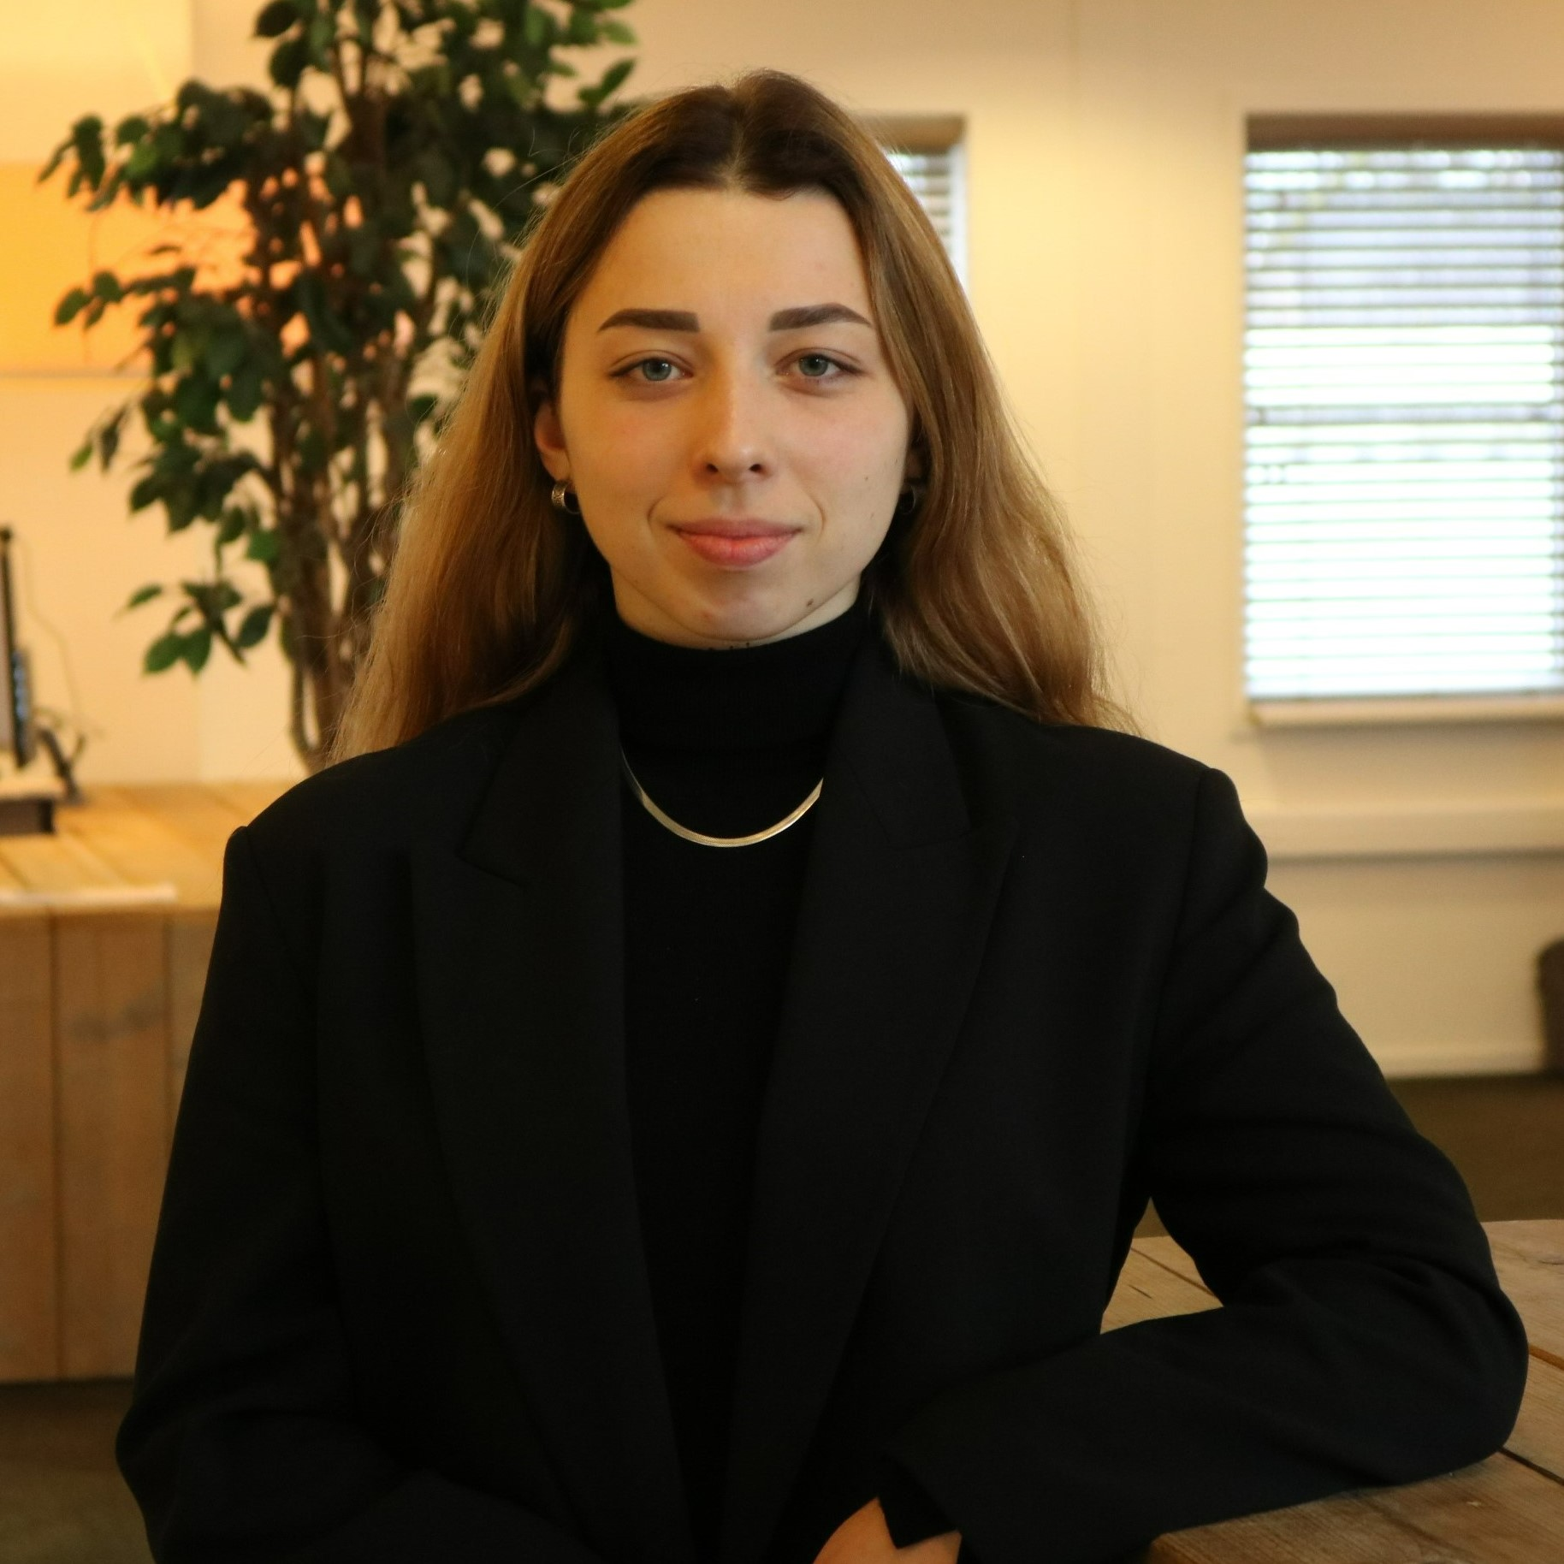
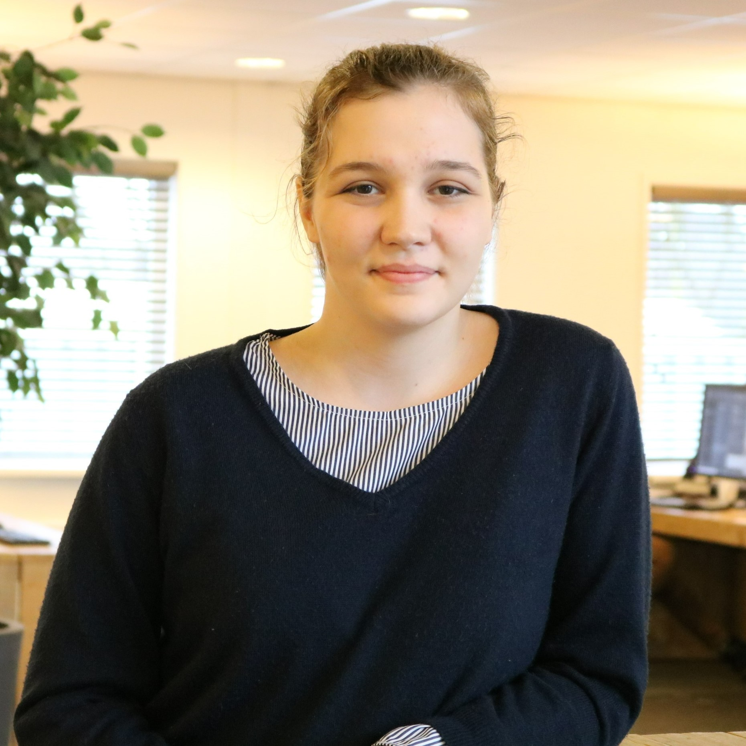
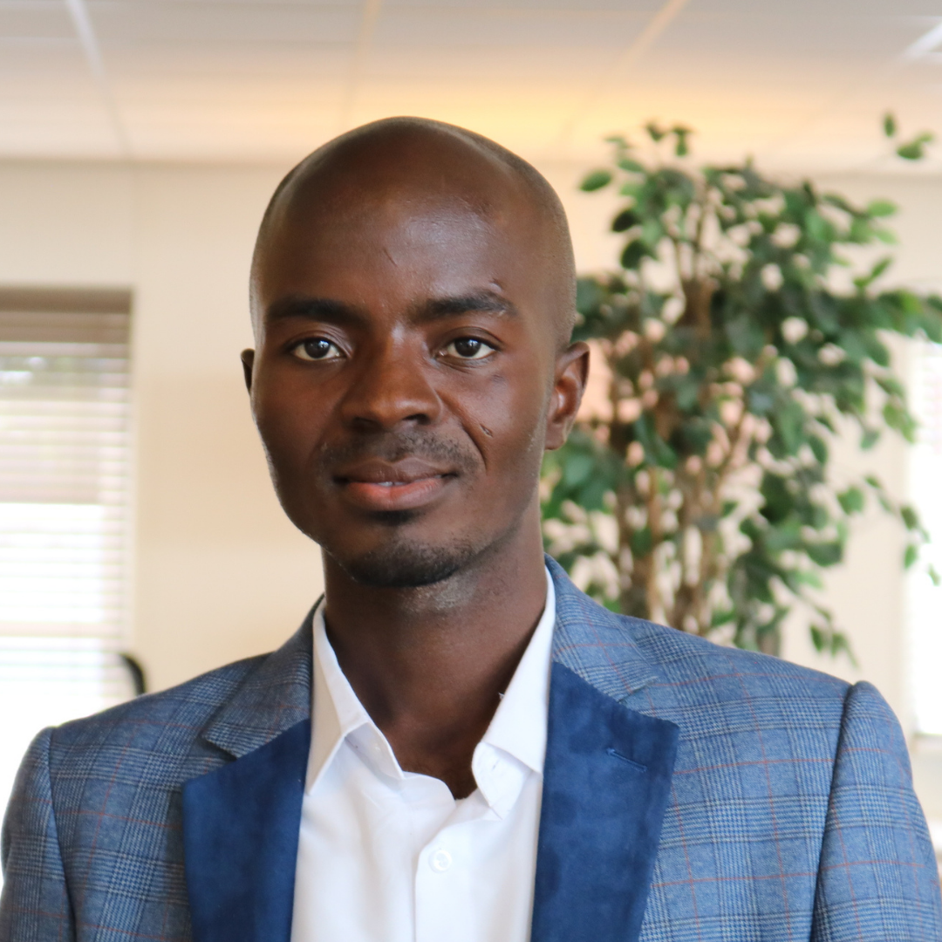
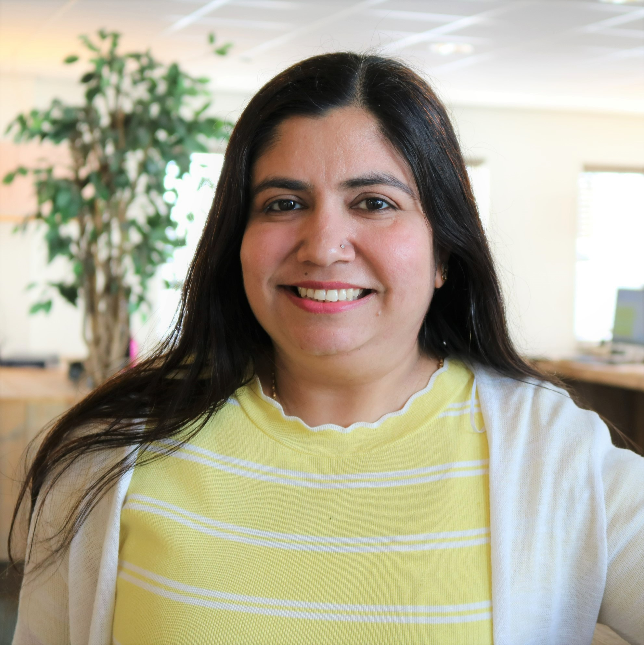
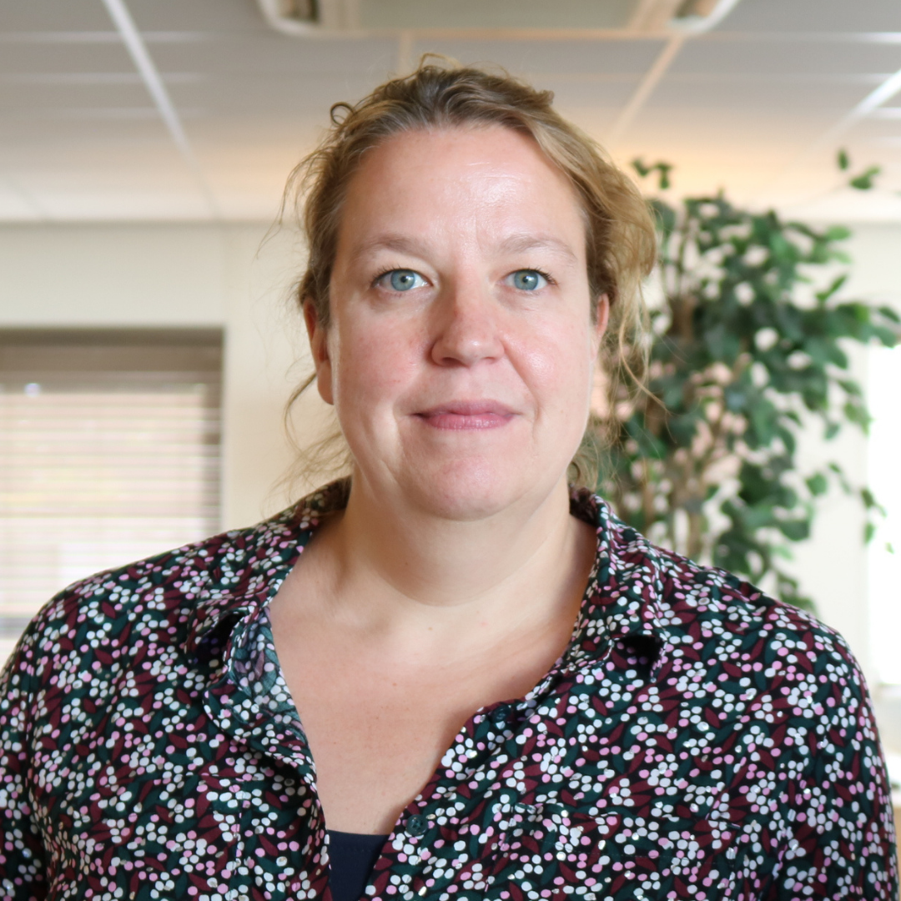
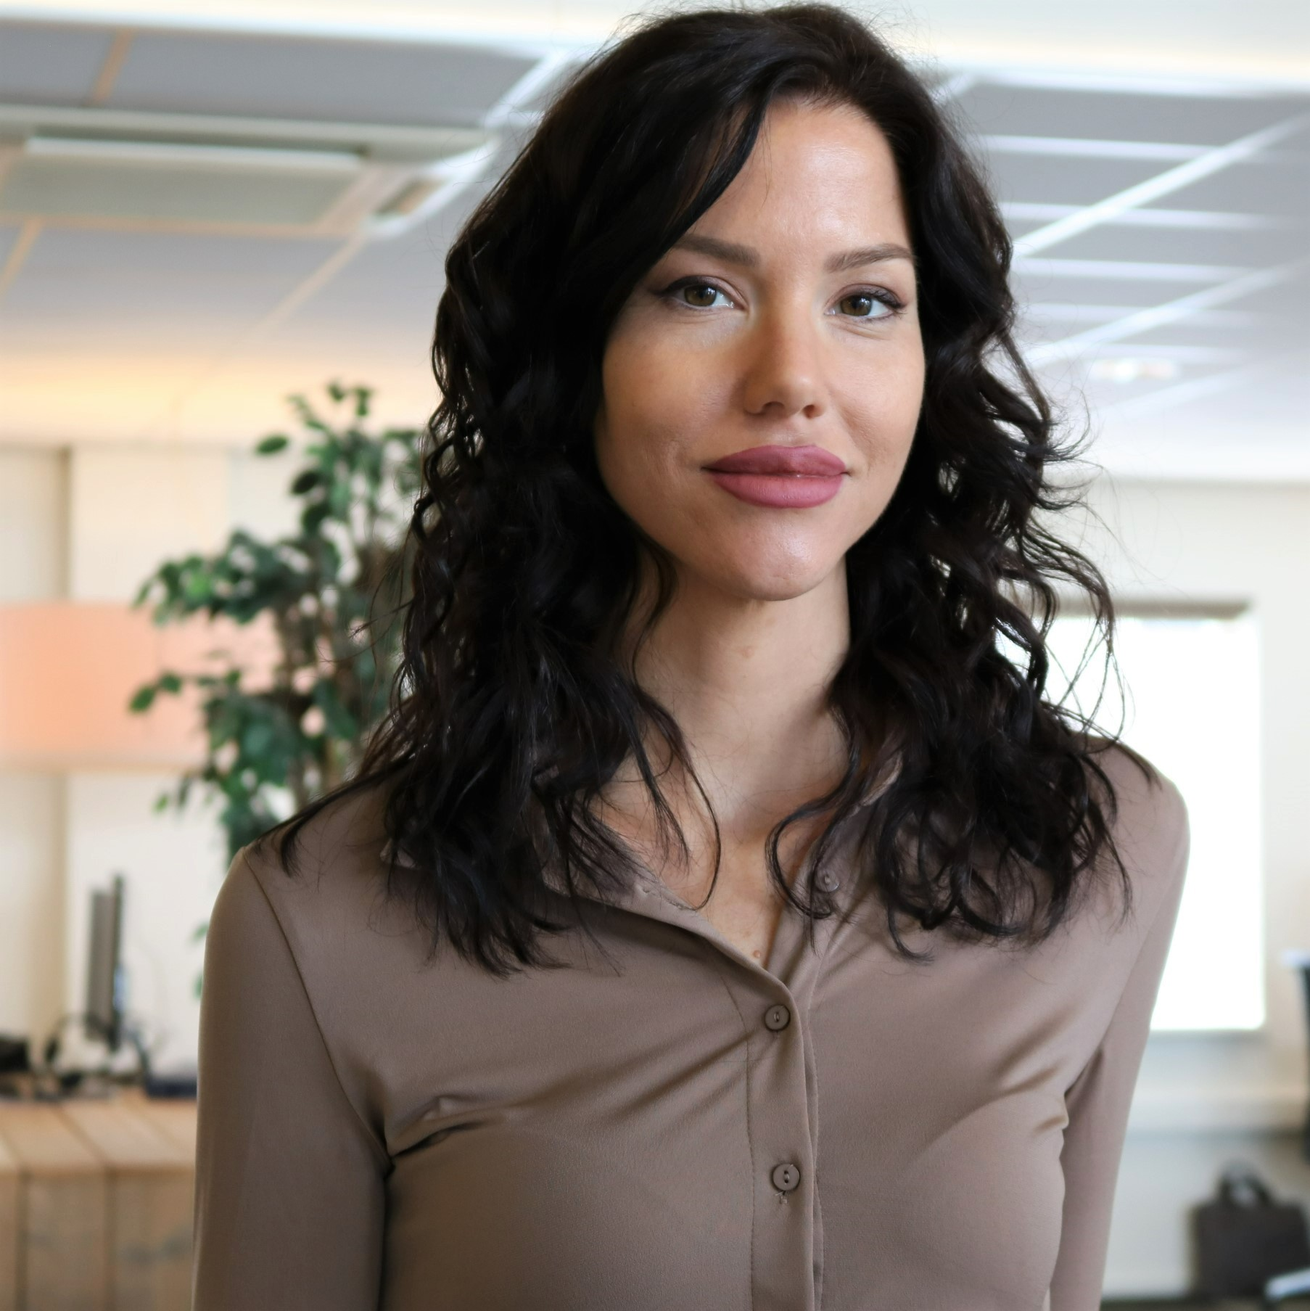
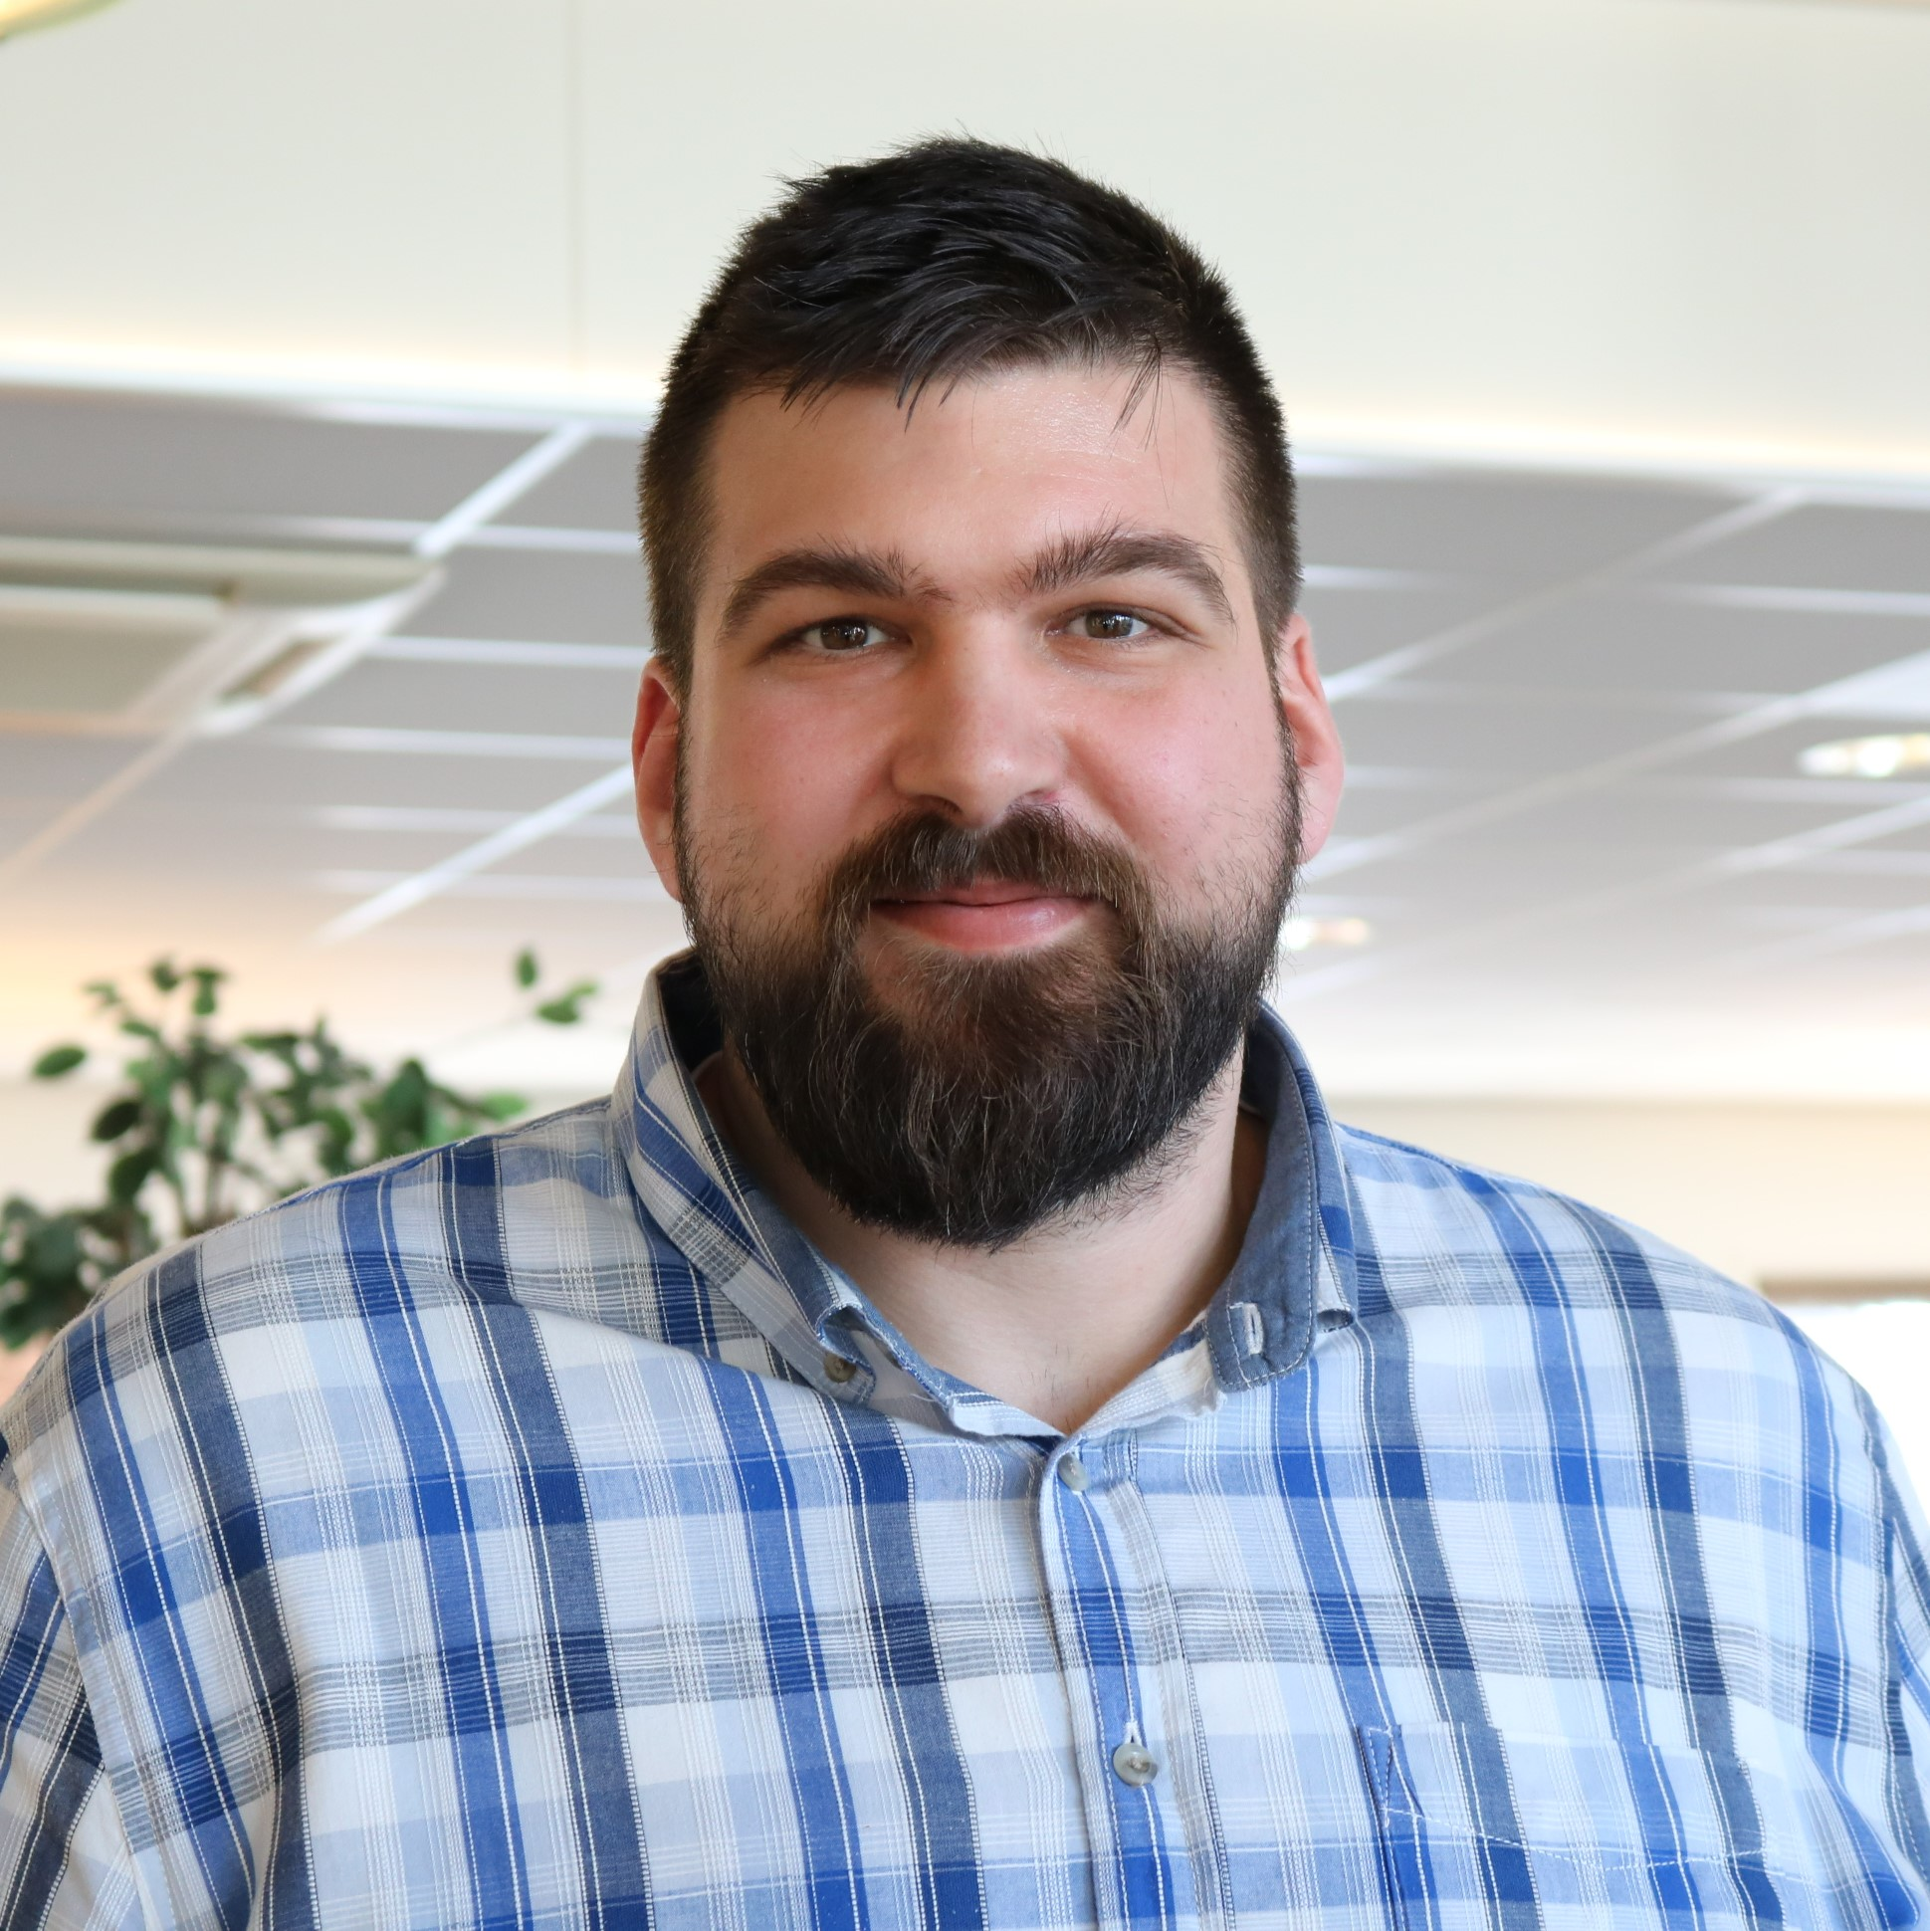
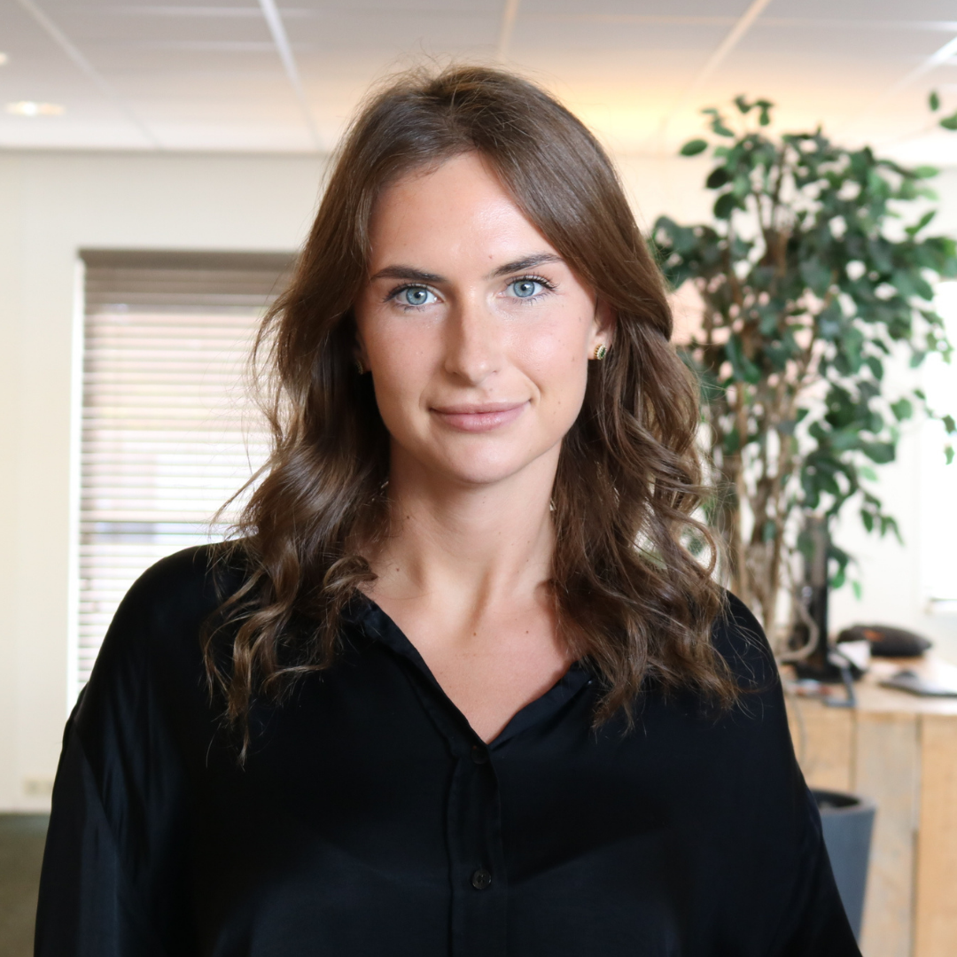
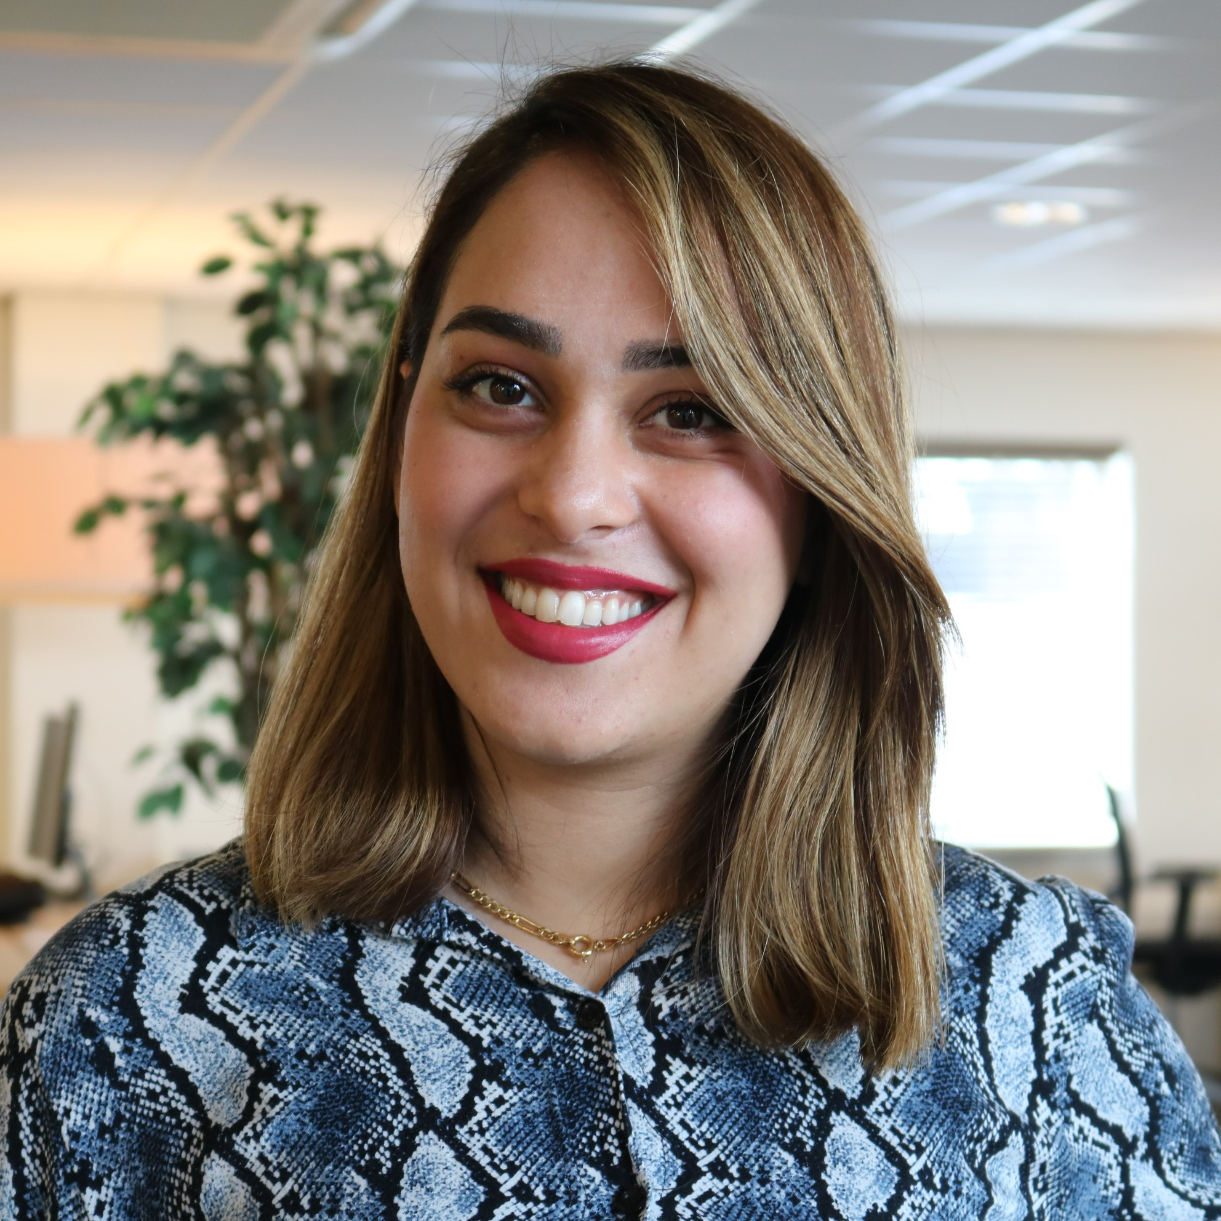
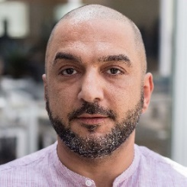












Meet our team
75
24
38
81
56
Team members
Nationalities
Languages
Bac/Ma %
Female %

Slide 5

Sales outsourcing
What we do
EuroDev will allocate a team of business development experts that dedicate part of their time to representing your company in Europe. This team will function as an extension of your sales team, working intimately together with you to grow the business organically.
Services:
  Setting up your European office
  Market research and strategy
  Lead qualification and creating a long list of potential end clients/distributors/OEM
  Visiting selected parties with you
  Determine long-term strategy
Your boots on the ground in Europe!

Slide 6
hr outsourcing
What we do
Are you looking for employment assistance in the European region? We got you covered! Whether it is through finding talent in the European region or outsourcing the liabilities and risks that come with being an employer overseas, we would like to partner up with you. The services make it possible to hire talent throughout Europe without creating/having a permanent establishment.
Services:
  Professional employer organization services (PEO)
  Employer of record services (EOR)
  Administration service organization (ASO)
  Recruitment services
  Payroll services
  HR consultancy services
  HR outsourcing
We aim at earning the privilege of making you successful in Europe!

Slide 7
Digital marketing
What we do
EuroDev will allocate a team of visual and technical digital experts to help you translate your digital strategy into a European context. Sensitive to local language, culture, and platforms, our team will design and execute a data-driven action plan to generate new business in Europe.
Services
  Digital marketing strategy development
  Website and landing page design
  Multilingual content creation
  Search Engine Advertising (Google Ads)
  Pay-per-click advertising (PPC)
  Search Engine Optimization (SEO)
  Remarketing and brand awareness campaigns
Ruled by data, driven by conversion!

Slide 8
Why work with us?
ONE STOP SHOP​
Full range of business development services ​
to grow your business European-wide​
​
YOU STAY IN CONTROL​
We are in it together, but you make ​the final decisions ​
​
SAVE TIME AND MONEY​
Effective and flexible solutions at ​every stage of your business growth​
​
DEDICATED​
A committed team with an unbiased and ​determined focus on creating success
SUCCESSFUL​
Our track record of more than 25 years means ​we know how to make you successful
MARKET KNOWLEDGE​
We know the markets, channels, and ​industry regulations in your niche​
​
BOOTS ON THE GROUND​
Have your own office and European team ​who understands the local culture
​
TRANSPARENCY​
Stay up-to-date through direct and frequent ​communication with your EU team​
TIME ZONE​
Your European team will be in the same time zone and able to address everything in a timely manner
WE SPEAK THE LANGUAGE
Our multi-lingual team can support all of your actions in any language needed

Slide 9















Contact us
Mark de Vries
CEO
m.devries@eurodev.com
Edward Nijland
COO
e.nijland@eurodev.com
Frans Wtenweerde
CFO
frans.wtenweerde@eurodev.com
Monique Ramondt-Sanders
Executive VP HR Outsourcing
m.ramondt@eurodev.com
Tim Vaesen
Executive VP Digital Marketing
t.vaesen@eurodev.com
Jose Prieto Moneo
VP Industrial
j.prieto@eurodev.com
Stephen Viljoen
VP Retail & Healthcare
s.viljoen@eurodev.com
Bart Leussink
VP Advanced Technologies
b.leussink@eurodev.com
Olga Hoving
Marketing Manager
olga.hoving@eurodev.com
Rebeca Vaillo
HR Manager
rebeca.vaillo@eurodev.com
EuroDev BV
Windmolen 22, 7609 NN Almelo
The Netherlands
Contact
Socials
+31 546 660 000
www.eurodev.com
instagram/eurodevers
linkedin.com/company/eurodev
info@eurodev.com

